Slide 1
Estate Planning and Management: Key features of the Succession Amendment Act, 2022. Wednesday 27 November 2024

Slide 2
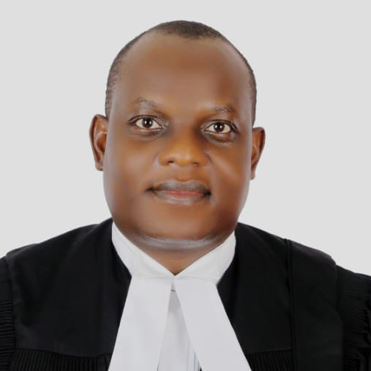
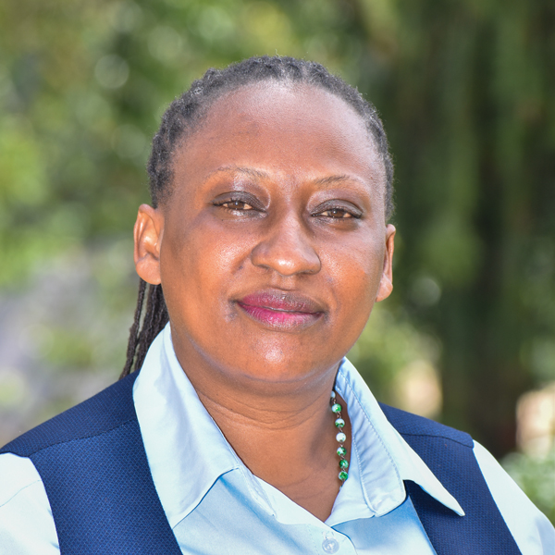
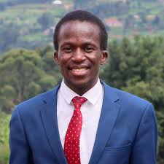
Presenters
Counsel Dalton Odomoch
Assistant Lecturer
Head of Department Public & Comp Law
Faculty of Law
Counsel Agnes Natukunda
Assistant Lecturer
Head of Department for Environmental Law
Faculty of Law
Counsel Ivan .K. Mugabi
Assistant Lecturer
Head of Department for Human Rights and Peace
Faculty of Law

Slide 3
PRESENTATION Layout
What are key definitions on Estate Planning?
Why is Estate Planning Important in Uganda?
What are the Key Elements of Estate Planning in Uganda?
What is Uganda’s Legal Framework for Estate Planning?
What is the role of Legal Experts in Estate Planning?
Why is will writing a necessary part of estate planning and succession.
What are the characteristics of a will?
What is the Background to the amending succession law in 2022?
What are the key areas of amendments or changes in the new law?

Slide 4
The key definitions on Estate Planning.
What is Estate Planning?
Estate planning is the process of arranging the management and disposal of a person’s estate during their lifetime and after death.
It involves making decisions about how your assets—such as land, property, savings, investments, and personal belongings—will be distributed among your heirs. A comprehensive estate plan can also address guardianship of minors, health care decisions, and end-of-life wishes.

Slide 5
The key definitions on Estate Planning.
What is Succession? The act or right of legally or offi­cially taking over a predecessor's office, rank, or duties. Or the acquisition of rights or property by inheritance under the laws of descent and distribution.
What is intestate succession? This is a situation when a person dies without leaving a valid will and as such their property (estate) must be shared out according to the Succession Act. An intestate person is a person who dies without a will.

Slide 6
The key definitions on Estate Planning.
What is testate succession? This is when a person dies leaving a valid will and therefore their estate is distributed according to the will.
Who is a spouse? Husband or wife married in accordance with the laws of Uganda or in accordance with the law of another country but recognized in Uganda as a valid marriage. Upon the death of one’s spouse, the survivor becomes a widow or widow.
Who is a son or daughter of a deceased person? Refers to legitimate and illegitimate children as well as children adopted in a manner recognized under the Laws of Uganda. Includes children adopted under the laws of other countries but recognized in Uganda as valid adoptions.

Slide 7
Why is Estate Planning Important in Uganda?
1. Preventing Family Disputes: In Uganda, disputes over inheritance, especially land, are common. Without a clear will or estate plan, your family could be left in conflict, leading to costly legal battles that can strain relationships.
2. Protecting Family Assets: Estate planning helps to protect family wealth from mismanagement or misuse. By specifying how assets should be handled, you can ensure that they are preserved for future generations.
3. Legal Compliance: Uganda’s legal framework has specific requirements for wills, trusts, and estate administration. Proper planning ensures that your estate complies with Ugandan law, reducing the risk of your wishes being challenged in court. (See for instance s.240 and s.242 of S.A on petitions of Grant of Probate & LOAs)

Slide 8
Many people globally, regionally, sub-regionally and domestically are dying intestate (Maurice BlackBurn, 2024.) WHY?
INACTION TO PLAN OR MAKE A WILL! BSE?
Superstitious concerns; that is, some think that making a Will is an invitation to death’s cruel hand or bringing your death nearer,
Others think that they still have many years to stay on this earth, and closely related to this,
Some think they will make one when they get old,
Others think that they need to accumulate more wealth before making a Will and others simply just don’t bother and completely ignore it.

Slide 9
Relevance of understanding succession law in Uganda
Estate Planning, Succession and Management law materially impacts the lives of all Ugandans.
Handling the estate of a deceased person can pose challenges, and
The transfer of property from one generation to the next is a customary practice deeply rooted in Ugandan culture.
Need to determine the Legal fate of the goods and debts of a natural person after death.

Slide 10
Key Elements of Estate Planning in Uganda
1. Wills:
A will is a legal document that outlines how your assets will be distributed after your death. In Uganda, a valid will must be written, signed, and witnessed by two competent individuals.
It’s essential to review and update your will regularly, especially after significant life events such as marriage, divorce, or the birth of children.
2. Trusts:
A trust is a legal arrangement where a trustee manages assets on behalf of beneficiaries. Trusts can be an effective way to manage and protect assets for minors or other dependents who may not be able to manage them responsibly on their own.
Uganda recognizes both testamentary trusts (created in a will and effective after death) and living trusts (created during a person’s lifetime).

Slide 11
Key Elements of Estate Planning in Uganda
3. Powers of Attorney:
o A power of attorney is a legal document that gives another person the authority to make decisions on your behalf if you become incapacitated. In Uganda, this can include decisions about finances, health care, and property management.
o Establishing a power of attorney ensures that someone you trust will manage your affairs if you are unable to do so.
4. Guardianship Designations:
If you have minor children, it’s crucial to designate a guardian in your estate plan. This ensures that your children are cared for by someone you trust if you are no longer able to do so.
In Uganda, the appointment of a guardian must be made through a will or a court application, and the guardian must act in the best interests of the child.

Slide 12
Uganda’s Legal Framework for Estate Planning
1. The Constitution of the Republic of Uganda, 1995 (as amended);
Article 26 Right to own property
2. The Succession Act, Cap 268, (as amended by Act No. 3 of 2022);
The Succession Act is the primary legislation governing wills, intestate succession (when a person dies without a will), and the administration of estates in Uganda. It outlines who is entitled to inherit and how estates should be distributed.
The Act provides for the protection of spouses, children, and dependents, ensuring that they are not left destitute after the death of the breadwinner.

Slide 13
Uganda’s Legal Framework for Estate Planning
3. Land and Inheritance Laws:
Land ownership is a significant aspect of estate planning in Uganda, where the majority of wealth is tied to land. Section 34 (1) paragraph 2 of the Land Act Cap. 236 provides for transactions with a tenancy by occupancy states that A tenancy by occupancy may be inherited.
Section 3 (2) of the Land Act provides for the various incidents of forms Freehold tenure is a form of tenure deriving its legality from the Constitution and its incidents from the written law which enables the holder to exercise, subject to the law, full powers of ownership of land, including but not necessarily limited to disposing of the land to any person either as a gift inter vivos or by will. (Section 3 (2) (b) (iv))
Other related legislation governs land inheritance, especially customary land, which is often subject to traditional laws and practices. It is essential to understand how customary and statutory laws interact in Uganda to ensure that your land is distributed according to your wishes.

Slide 14
Uganda’s Legal Framework for Estate Planning
Other legislations include:
4. The Administrator General’s Act, Cap. 264:This office assumes powers over estate of the deceased until letters of administrations or letters of probate are granted by court on applying.
5. The Administration of Estates (Small Estates) (Special Provisions) Act Cap.263: This law regulates estates of deceased with property is below a specific monetary thresholds.
6. The Estates of Missing Persons (Management) Act, Cap. 266:This law governs and is applies to estates of persons who persons who have been proven to have gone missing declared as such by a court order.
8. The Children’s Act, Cap 62: This law generally relates to children in general without discriminating between legitimate and illegitimate children.
9. Case Law/ Judicial Decisions such as Advocacy for Women in Uganda vs AG, Const Pet.

Slide 15
The Role of Legal Experts in Estate Planning
Given the complexity of Uganda’s legal framework and the potential for disputes, working with legal experts is crucial in estate planning. Lawyers specializing in estate law can help you:
• Draft a valid will or trust that reflects your wishes.
• Ensure compliance with Ugandan law to prevent challenges to your estate plan.
• Advise on the best strategies for protecting your assets and minimizing tax liabilities.
• Provide guidance on managing customary land and other complex inheritance issues.

Slide 16
Counsel Agnes
Counsel Agnes starts from this slide.

Slide 17
Why is will writing a necessary part of estate planning and succession.
Some people think that only the very wealthy or those with complicated assets need wills. However, there are many good reasons to have a will
It enables you to ne can be clear about who gets your assets. You can decide who gets what and how much.
You can keep your assets out of the hands of people you don't want to have them (like an estranged relative).

Slide 18
Why is will writing a necessary part of estate planning and succession.
Peace Of Mind: Creating a Will can give you peace of mind, knowing that everything is in place if you suddenly die or suffer a prolonged illness. If you are critically ill, you may be unable to write a well-thought-out Will, fulfilling all the necessary legal requirements to make it valid. So, planning your estate and writing it down in a Will while you still can is prudent. Your heirs will have a faster and easier time getting access to your assets.
Save estate from certain taxes: You can plan to save your estate from paying money on taxes. You can also give gifts and charitable donations, which can help offset the estate tax.

Slide 19
Why is will writing a necessary part of estate planning and succession
Family Security: It will secure your children, mainly if they are minors. Instead of an overbearing distant relative taking charge, you can decide who will take care of the matters after you are gone. You can identify who should care for your children. Without a will, the courts will decide.
Digital Assets: You can secure your digital assets, like your digital files, social media, etc., which your family members may need to be made aware of. While writing a Will is simple, a few requirements are necessary to make it valid.

Slide 20
Key Considerations in Will writing
▪ Legal Capacity: The person making the will must be of sound mind at the time of the creation of the will. The test to determine if the person has the requisite capacity is if the testator knows that he or she has made a will, understands its effect and understands the nature.
▪ The will must be executed free of fraud, duress, undue influence. Fraud involves false statements of material facts, known to be false by the party making the statements, made with the intention of deceiving the testator who is actually deceived and that cause the testator to act in reliance on the false statements. Fraud can be deception of an illiterate testator. (S. 36 of S.A)

Slide 21
Key considerations in Will writing - Cont
A testator’s will cannot be amended after his death to include anything he/she could have omitted. A provision included in a will by mistake may be omitted and separated from the rest of the will just in the same way that an illegal or conflicting provision in a contract can be eliminated leaving the rest of the contract valid.
Owned Property: A will must dispose of only the property that is part of the decedent’s estate.

Slide 22
Additional Considerations in Will writing
Beneficiaries: The will should state that the property is being disposed of by transferring it to a particular person or entity that is ascertainable. This may be to a person, business, group of people such as my children or my living grandchildren) or charitable organization.
Executor: An executor should also be named in a will. This is the individual who follows the instructions of the will. If an executor is not listed, the court may appoint one.
The Testator and Witnesses must sign or thumb mark on each and every page of the Will as required by the new law.
The Testator shall not distribute in a Will the principal residential holding and other residential holdings.
The Testator shall provide for the spouse, lineal descendants and dependent relatives in the Will.

Slide 23
Requirements of a valid will
It must be in writing, and state the particulars of the person making it.
The will must be dated since the date is usually the point of reference as to its validity.
The beginning of the will should state that it revokes all others. If you have an earlier will, you should destroy it.
The person making the will (testator) must have a sound mind.
The testator must have made the will voluntarily and without pressure from anyone else.

Slide 24
Important to Note/ Recommended that:
Beneficiaries of the will, their spouses or civil partners shouldn’t act as witnesses, or they lose their right to the inheritance!
Beneficiaries shouldn’t even be present in the room when the will is signed. It’s also best not to ask an executor to act as a witness.
Every person above 18 years can make a will but must be of sound mind to make one.
A person can make an entirely new will or make slight alterations to the old one through an addition to your will (codicil)… (s. 37 of S.A)

Slide 25
Important to Note/ Recommendation Cont.
All correct legal steps/ requirements should be taken to make the will legally acceptable.
Marriage makes an existing will void which means that you must always make another will when you marry.
Always make 2-3 copies of your will and give it to persons you trust (friend, family, bank, lawyer, insurance company, LC official, elder, religious leader, etc.) Note that under S.A, custody of will can be with Registrar or Chief Reg. for safe keeping. The person must make the last will known immediately after your death.
It is illegal to steal, conceal, destroy or forge a will! All these are offenses and are punishable by imprisonment for up to ten years or more.

Slide 26
CONSIDER CHANGING YOUR WILL WHEN:
You acquire more property or lose property.
You get married.
You divorce and/ or remarry.
You want to change the heir/heiress or the original heir/heiress has died.
A person who was given a share in your will dies.
One of your witnesses dies.
You or your wife gives birth to another child or when you legally adopt another child.

Slide 27
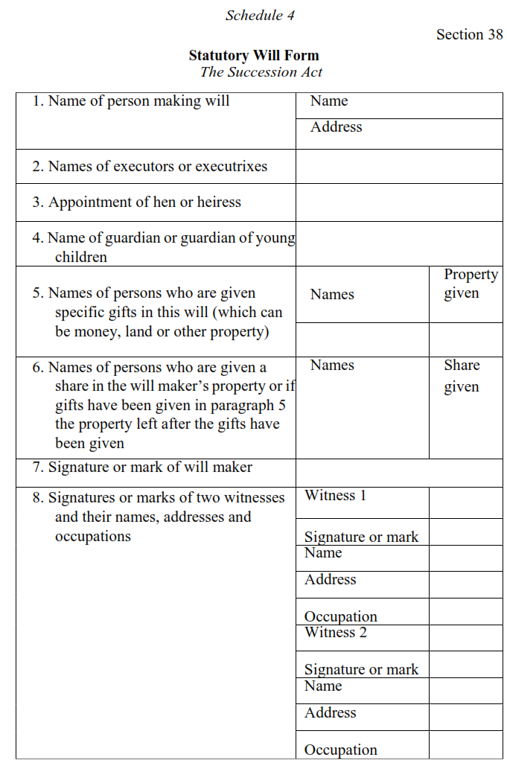
FORM OF A STATUTORY WILL (S. 38 & Sch. 4 of S.A)

Slide 28
Dalton on 2022 Amendments of the S.A
Csl Dalton’s part starts on Amendments in the succession Act

Slide 29
Background to the amending succession Act in 2022
Need to Accord Equal Rights to Men and Women per constitutional provisions and other international laws and covenants Uganda is a signatory to, Equity, Natural Justice to mention but a few.
Protect the rights of those occupying the principal and other residential Holdings
Increase the share of the surviving spouse in the estate.

Slide 30
Situation before the Amendment of the Succession Act, Cap. 264
Distribution of property favored the male over the female beneficiaries
Where a husband passed on, the surviving wife was entitled to only 15% of the deceased person’s property
Only heirs (male) were entitled to get a share in the deceased person’s property.
There was discrimination between children born in wedlock (legitimate) and those born out of wedlock (illegitimate) in the distribution of property.
Those who were connected by marriage or related to the deceased person can obtain letters of administration
Letters of administration expired after 3 years.

Slide 31
Con’t on Situation before the 2022 amendment of SA
The expiration of probate was one year or the court could determine the time of expiry.
The residential holding was preserved for the heir.
A guardian is appointed either in a will or by the court.
It was not a must for a witness of a will to sign on all the pages of a will.

Slide 32
Rationale for the amendment continuation
Provide for the welfare of minor(s) and dependent adult children
Improve the law and make it more modern by removing offensive terms (such as lunatic, illegitimate children
To take into consideration and comply with the recent decisions of the courts including the constitutional court rulings and
Generally to bring the law to parity with the 1995 constitution and other laws.

Slide 33
Effect of Constitutional Court Judgement in the case of Advocacy for Women in Uganda vs AG, Const Pet. 13/2005 & 05/2006
Court declared s.2(n)(i) and (ii), 14, 15, 26, 27, 29, 43 & 44 of the Success Act, cap 162 and rules 1,7, 8 &9 of the 2nd Schedule of the S.A inconsistent and contravened Articles 21(1), (2) (3), 31 & 33 of 1995 Constitution. Thus null and void. This ruling created lacunae and gaps in the domestic Succession legal regime.
The provisions of the act were discriminatory on the basis of sex. Sections 2(n)(i) and (ii)of the Succession Act defining “legal heir” provided that a male heir was preferred to a female one. The provisions of sections 14 and 15 provided only for the domicile of a wife during marriage and there was no provision for a husband to take the wife’s domicile.

Slide 34
Case of Advocacy for Women in Uganda vs AG, Const Pet. 13/2005 & 05/2006 (Cont
Sections 26 and 29 and rules 1, 7, 8, and 9 of Schedule 2 to the old Act provided for occupancy of the matrimonial home in which a woman ceased to occupy the principal residential property if she married but was silent on the same for men who remarry.
Section 27 of the old Act, which governed the distribution of property of intestate deceased persons, had no provision for female intestate and under sections 43 and 44 of the Act, it was only a father who, by will, could appoint a guardian or guardians for his child during minority.
The Act was declared discriminating on basis of sex and did not accord equal treatment in the division of property between males and females.

Slide 35
Changes in the Estate Succession Legal Regime following the 2022 Amendment of the S.A
Both male and female beneficiaries have equal shares in the distribution of the deceased person’s property.
Where the deceased is survived by a spouse, dependent relatives, and customary heir or heiress; and no lineal descendant, the wife is entitled to 50% of the deceased person’s property.
Both heir (male) and heiress (female) are entitled to a share of the deceased person’s property.
All children born in wedlock or outside wedlock are considered as children of the deceased person and are entitled to equal share in the deceased person’s estate.

Slide 36
Changes introduced by Amendment of S.A
Preference is given to the surviving spouse to obtain letters of administration.
The expiration date was reduced to 2 years from the date of the grant of letters of administration.
The expiration date of probate is 2 years from the date of grant of probate.
The residential property has been preserved for the surviving spouse, lineal descendants and dependent relatives.
A guardian may also be appointed by family members.
It is a must for a witness of a will to sign and state his or her name and address on each page of a will.

Slide 37
Offences and Penalties under the Succession Act, cap. 268
Intermeddling: This is where a person who has not obtained letters of administration or probate takes possession or distributes the property of a deceased. (Penalty: Imprisonment for a maximum of 10 years or a fine not exceeding UGX 20,000,000/= (Twenty Million Shillings) or both. The court may also order the offender to compensate the estate or beneficiaries.) (S.265 of S.A)
Eviction of a beneficiary who is entitled to occupy a residential property: Evicting a surviving spouse, lineal descendant or dependent relative from the residential home that such beneficiary is already occupying (Penalty: Imprisonment for a maximum of 7 years or a fine not exceeding UGX 3,360,000/= (Three Million Three Hundred Sixty Thousand Shillings) or both) (s.22 of S.A)

Slide 38
Offences and Penalties cont.!
Misappropriation of the estate of the deceased: An administrator or executor who before the grant of letters of administration or probate misapplies or subjects the estate to loss or damage (Penalty: imprisonment for a maximum of 2 years or a fine of UGX 960,000/= (Nine Hundred Sixty Thousand Shillings) or both) (S.265 of S.A)
Fraudulent acquisition of letters of administration or probate: a) Forgery of letters of administration or probate. b) Forgery of documents used in applying for letters of administration or probate. (Penalty: Imprisonment for a maximum of 3 years or a fine of UGX 1,440,000/= (One Million Four Hundred Forty Thousand Shillings) or both) (s. 230, S.A)
Occasioning loss to the estate through negligence: This may include selling off property at a value lower than the market value or letting property lose value without reasonable excuse for example by not repairing it while one has money such as rent from houses. (Penalty: imprisonment for a maximum of 3 years or a fine of UGX 2,000,000/= (Two Million Shillings) or both The court may order the offender to compensate the beneficiaries) S. 265, 328 of SA)

Slide 39
Offences and Penalties continued
Taking possession of an estate for a period of more than 3 months without letters of administration or probate: Failure to report to the Administrator General within three months from the time of death. (Penalty: Imprisonment for a maximum of 10 years or a fine of not exceeding UGX 20,000,000/= (Twenty Million Shillings) or both) (S.265(8) SA)
Refusing or neglecting to hand over the property to the Administrator General when called upon to do so: Actual refusal or delay to hand over property when asked by Office of the Administrator General (Penalty: Imprisonment for a maximum penalty of 3 years or a fine of UGX 1,440,000/= (One Million Four Hundred Forty Thousand Shillings) or both) (s.265(8) SA)
Misappropriation of property of a minor by a guardian: Applying income of a minor from the estate to personal use. (Penalty: Imprisonment for a maximum of 5 years or a fine not exceeding UGX 3,000,000/= (Three Million Shillings) or both The court may order the offender to compensate the beneficiaries) (S.44(4) of SA)

Slide 40
Offences and Penalties under the Succession Act
Willfully and without reasonable cause omitting to deliver a revoked probate: Refusal to deliver revoked or cancelled letters of administration to the court that issued them (Penalty: imprisonment for a maximum of 3 years or a fine not exceeding UGX 1,440,000/= (One Million Four Hundred Forty Thousand Shillings) or both.) (S.230(3) SA)
Acquiring part of the share of beneficiaries in an estate for services rendered: Where the lawyers and or land agents use part of the estate to pay for the services they rendered to the beneficiaries. For example, in assisting them register their interest in land. (Penalty: Imprisonment for a maximum of 5 years or a fine not exceeding UGX 2,400,000/= (Two Million Four Hundred Thousand Shillings) or both.) (s.329(2) SA)

Slide 41
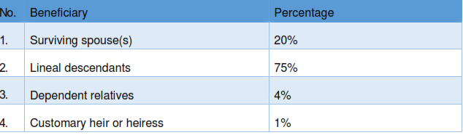
RULES OF DISTRIBUTION SUMMARIZED (S.23 of S.A, cap 264) 1. Where the deceased is survived by a spouse, lineal descendants, dependent, relatives and customary heir or heiress.

Slide 42
2. Where the deceased is survived by a spouse who has no children but the deceased person had children outside the marriage.
In this case there is no discrimination against children born out of wedlock.
Children born in or outside the marriage have the same entitlement under the law.
Ref also to Arts. 21, 34 of 1995 Const’n, decision of court in Kabali vs. Kajubi [1944] 11 EACA and Parl. Comm on Legal Affairs rep. on SA Ammendment Bill, 2019.

Slide 43
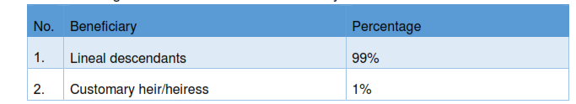
3. Where the intestate leaves no surviving spouse or dependent relative specified in paragraph or no spouse or relative capable of taking a proportion of his or her property

Slide 44
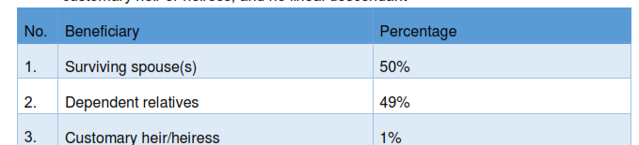
4. Where the deceased is survived only by a spouse, dependent relatives, and customary heir or heiress; and no lineal descendant

Slide 45
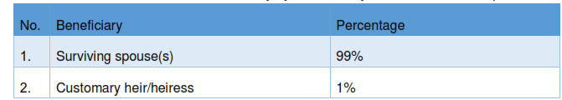
5. Where the deceased is survived only by a customary heir or heiress and spouse

Slide 46
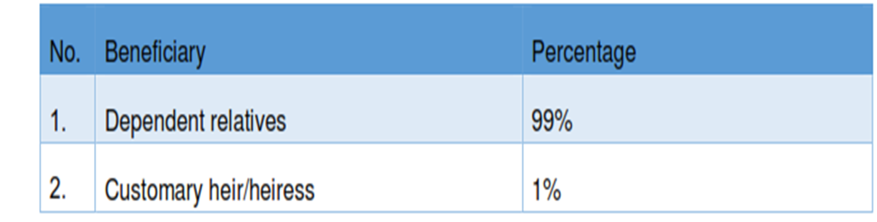
6. Where the deceased is survived only by a customary heir or heiress and dependent relative

Slide 47
7. Where the deceased is survived by only a customary heir or heiress and there is no surviving spouse, lineal descendants nor dependent relatives.
The property is divided equally amongst the deceased person’s nearest relatives. These relatives may include the deceased person’s mother, father, sister, brother, aunt, uncle, niece, nephew.

Slide 48
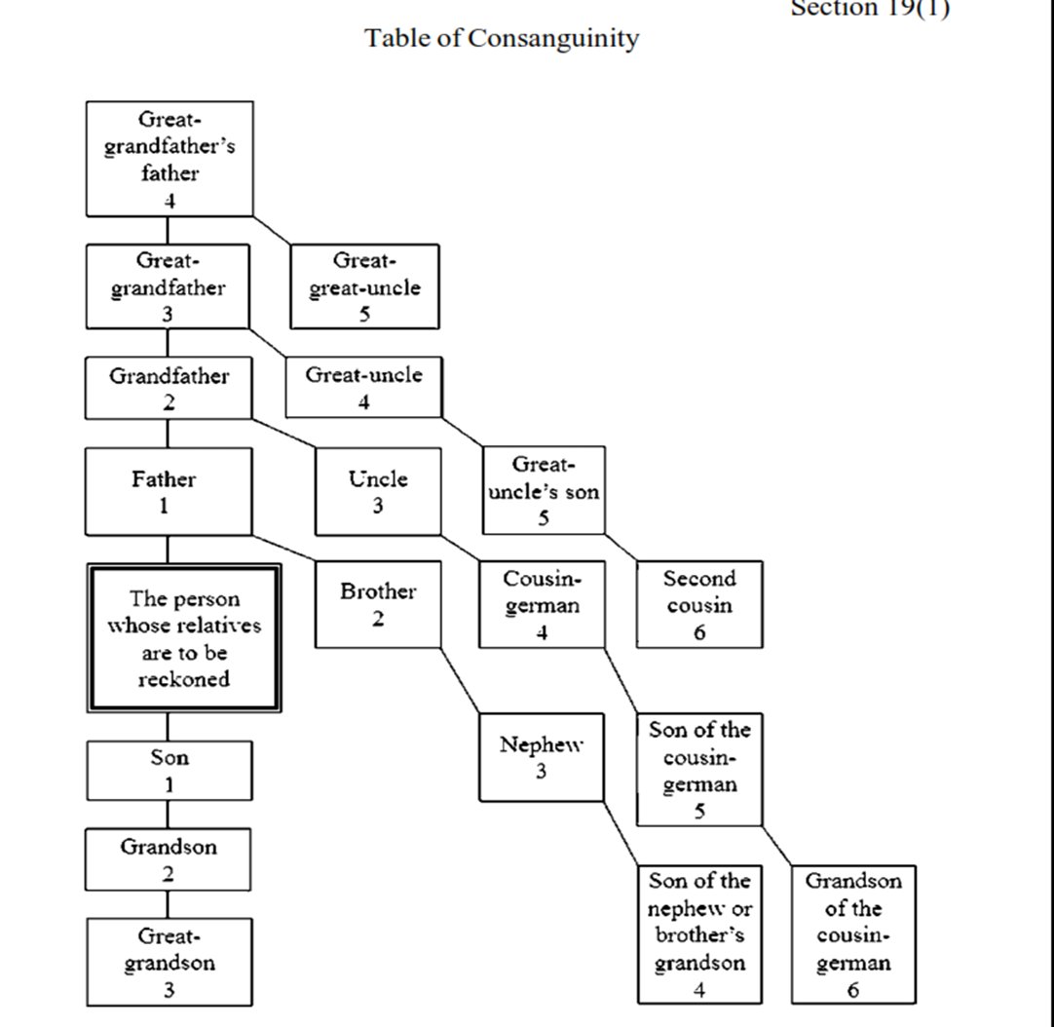
Table of Consanguinity

Slide 49
Thank you | Asante | Mwebare
Questions? Thoughts? Suggestions?

