Slide 1
Some Academic Resources & Diversity Visa Program
Resources for Teaching, Research, & Immigration

Slide 2
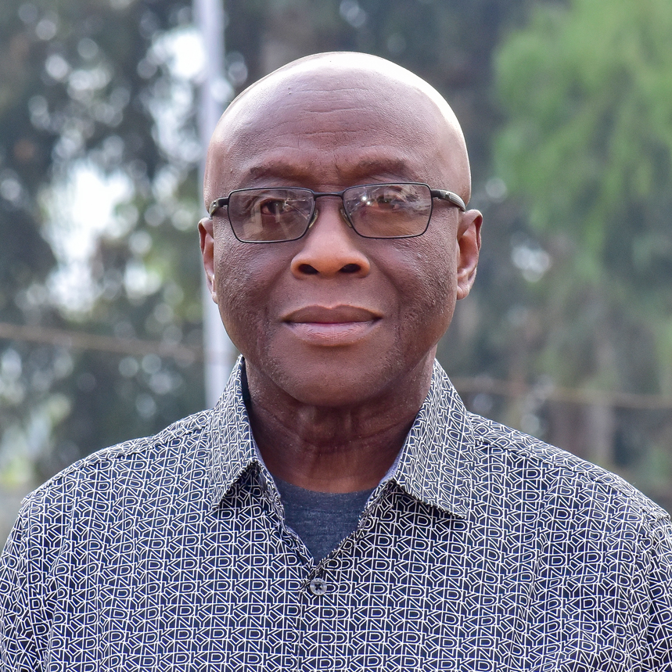
Presented by
Dr. Roger Klomegah
Assoc. Prof | Faculty of Social Sciences
Full Bright Scholar
Professor | Tennessee State University

Slide 3
Fellowships: Highered jobs
Jobs in higher education
HigherEdJobs - Jobs in Higher Education

Slide 4
Fellowships: Chronicle of Higher Education
The Chronicle of Higher Education | Higher Ed News, Opinion, & Advice

Slide 5
Scholarship opportunities: education USA
Study in the U.S.A. - U.S. Embassy in Uganda (usembassy.gov)
EducationUSA Scholarship Opportunities - U.S. Embassy in Uganda (usembassy.gov)
EducationUSA Scholarship Opportunities - U.S. Embassy in Uganda (usembassy.gov)

Slide 6
Scholarships
Scholarships for International Students | BestColleges

Slide 7
DV Lottery
For those interested in lottery and relocation

Slide 8
State Department website
Electronic Diversity Visa (state.gov)
Check your status here if you played last year
Electronic Diversity Visa (state.gov)

Slide 9
Publications and conference presentations
Use pre-collected datasets (data sets) for secondary analysis.
Do systematic reviews of the literature.

