Slide 1
KABALE UNIVERSITY DIRECTORATE OF ICT SERVICES-(DICTS)
Presentation to Heads of Departments

Slide 2
About DICTS
In general, DICTS serves as an enhancement for ICT for educational excellence for Kabale University.
DICTS is always at the front end for harnessing the power of ICT for enhanced quality service delivery in all the core functions of the University …
With a dedicated team of professionals, we strive to provide a cutting edge technology solutions.
Mission: To electronically operate extensively academic and administrative functions of the University.

Slide 3
2. Human Resource - DICTS
Murangira Jones (Deputy Chief)
Tumusiime Robert (Snr. E-learning Officer)
Isaac Tweterane (Snr. Sys. Admin Officer)
Ampaire Ray Brooks (Sys. Admin Officer)
Barigye Leodnas (Systems Administrator)
Nowamani Collins (Web Systems Administrator)
Michael Mutebi (Systems Libraran)
Mabirizi Vicent (Instruction Design Officer)
Sonko Denis Nsibambi(ICT Officer)
Collins Nuwagaba (E-learning Officer-Multimedia)
Ahimbisibwe Deus (Ass. ICT Officer)
Tumukunde Hillary(Ass. ICT Officer)
Aja Sharon(Ass. Ict Officer
Chemutai Lisa (Ass. ICT Officer)
Tumuhimbise Robinah(Ass. ICT Officer
Atwine Simon Alex(Ass. ICT Officer)
Ahabwe Emmanuel(Ass. ICT Officer)

Slide 4
2. Human Resource: Library Services Unit
Dr. Bernard Bazirake Bamuhiiga (University Librarian)
Odongo Patrick (Snr. Librarian)
Namara Phiona (Librarian I)
Kembabazi Prudence (HoD – Reference & User Services)
Innocent Niyonsaba (HoD – ICT & Periodicals)
Kyomugisha Rachael (Asst. Admin Officer)
Atwebembeire Jerome (Librarian II)
Mwesigye Kenneth (Librarian II)
Ensikweri Medard (Librarian II)
Ayesiga Stella (Librarian II)
Isingoma Fenekansi (Librarian II)
Ayesiga Stella (Librarian II)
Natukunda Elizabeth (Librarian II)
Birungi Cleophas (Librarian II)
Asiimwe Editor (Librarian II)
Atuha Peter (Librarian II)
Clare Ninsiima (Systems Administrator)
Kagwa Andrew (Library Assistant)
Muhanguzi Shadrach (Library Assistant)
Arahe Glorius Turahe (Library Assistant)
Human Resource Capacity

Slide 5
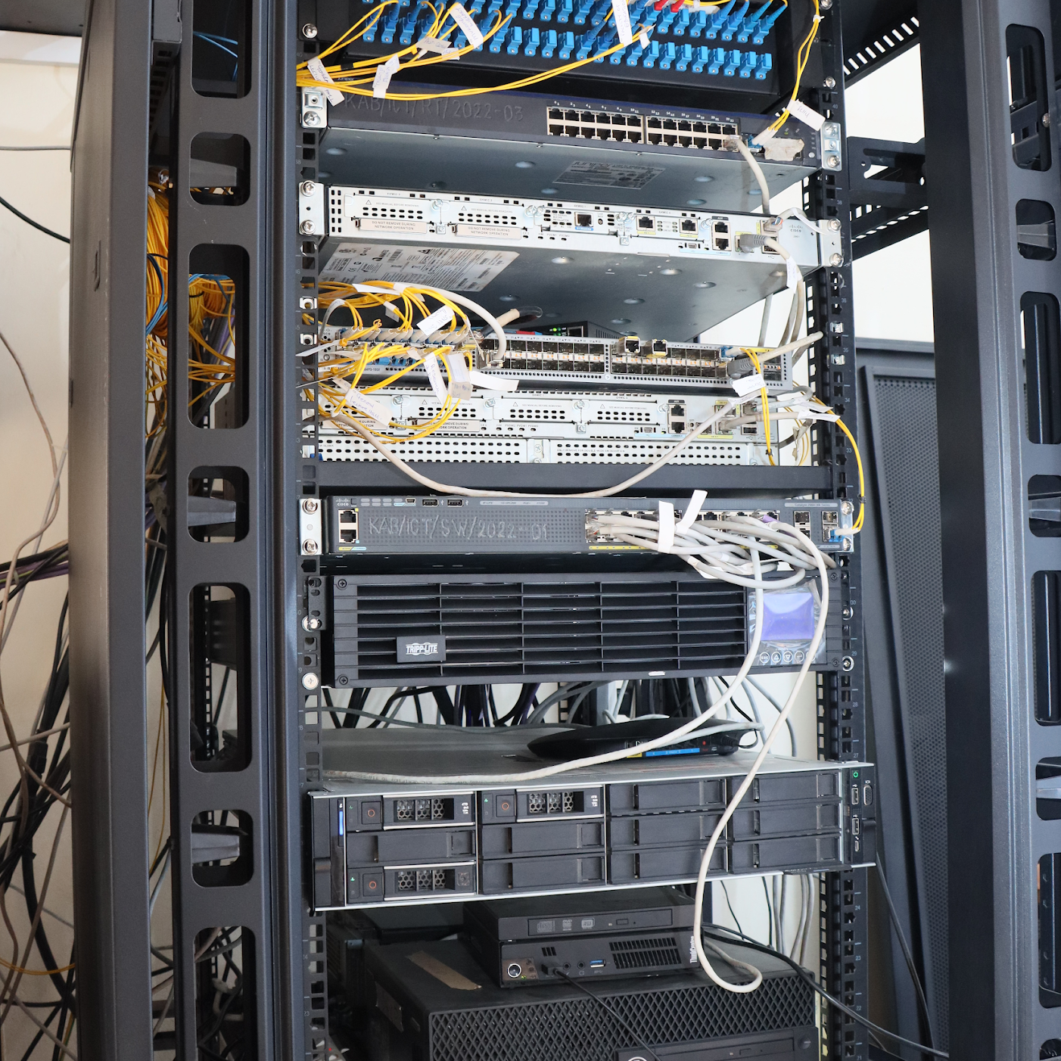
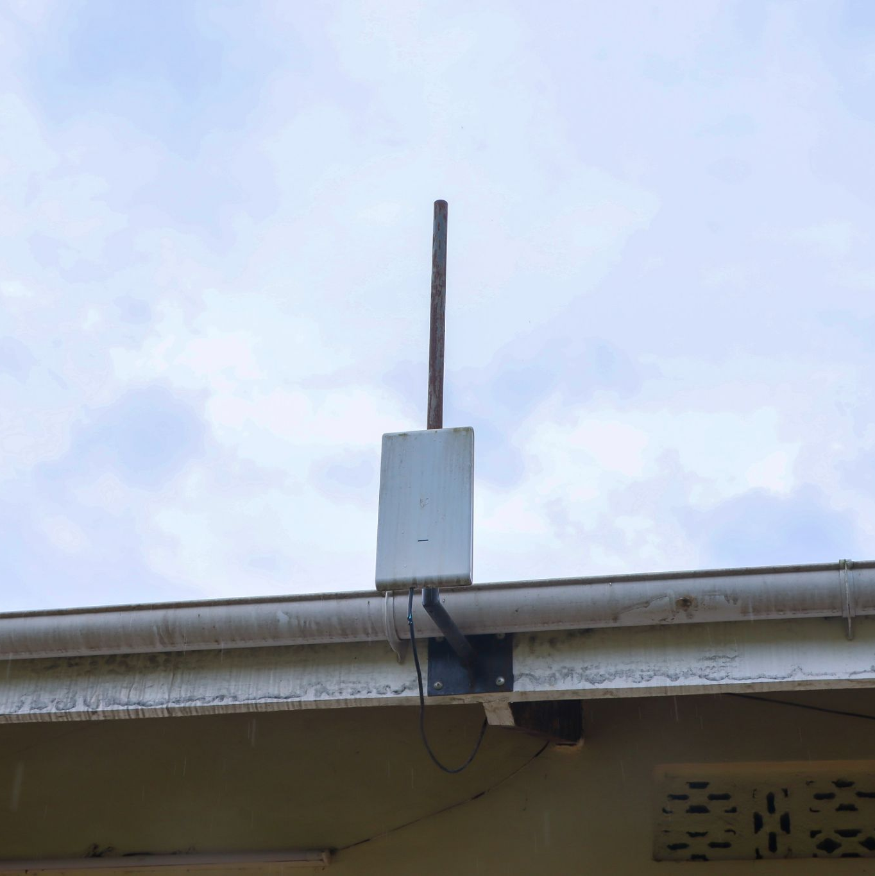
ICT Infrastuctre- Networks
# | Item | Details
1 | Internet Bandwidth | 456MBPS from 230 effective 15th March,2024 Main campus=300mbps from 150mbps, Kabsom=74mbps from 40mbps, Engineering=74mbps from 40mbps
2 | Campus Internet Coverage | 60%- continue to expand (kabsom hostel Most recent)
3 | Connection Type | Fiber Optic Connection | Layer 3 switches with power backups-inverters installed
4 | Access Type | Wired, Wi-Fi (Eduroam and metro eduroam)
5 | State-of-the-art Server | PowerEdge R740 Xeon E5-2650 v4 2.3GHz; 12TB HDD 48 Core; 96GB RAM
6 | Service Provider | RENU-Primary; NITA-U-Secondary

Slide 6
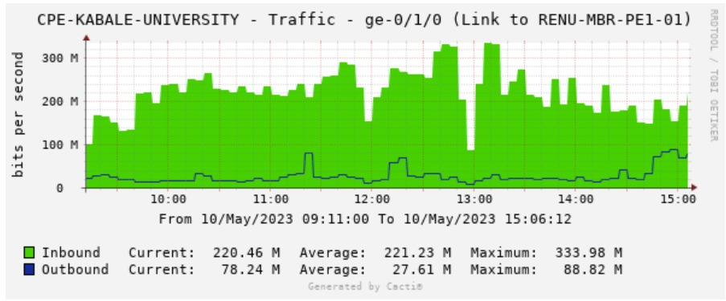
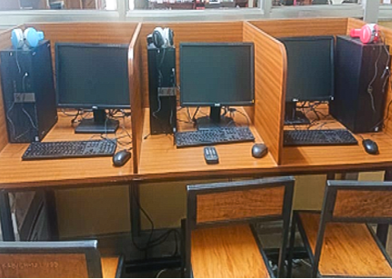
CACTI GRAPHS ON INTERNETUSAGE-
(Main Campus)-Tests
ICT Infrastructure udates

Slide 7
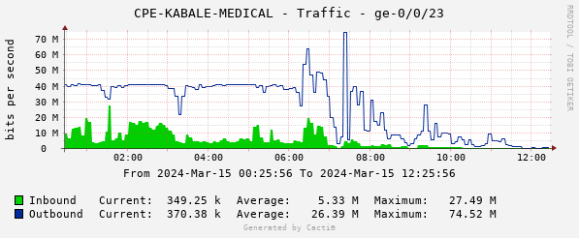
CACTI GRAPHS ON INTERNETUSAGE- (KABSOM)-Test

Slide 8
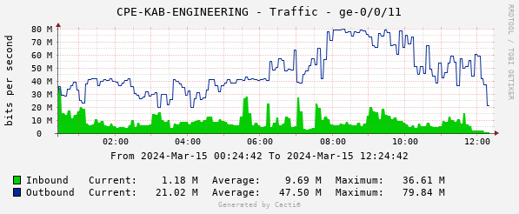
FACULTY OF ENGINEERING(Test)

Slide 9
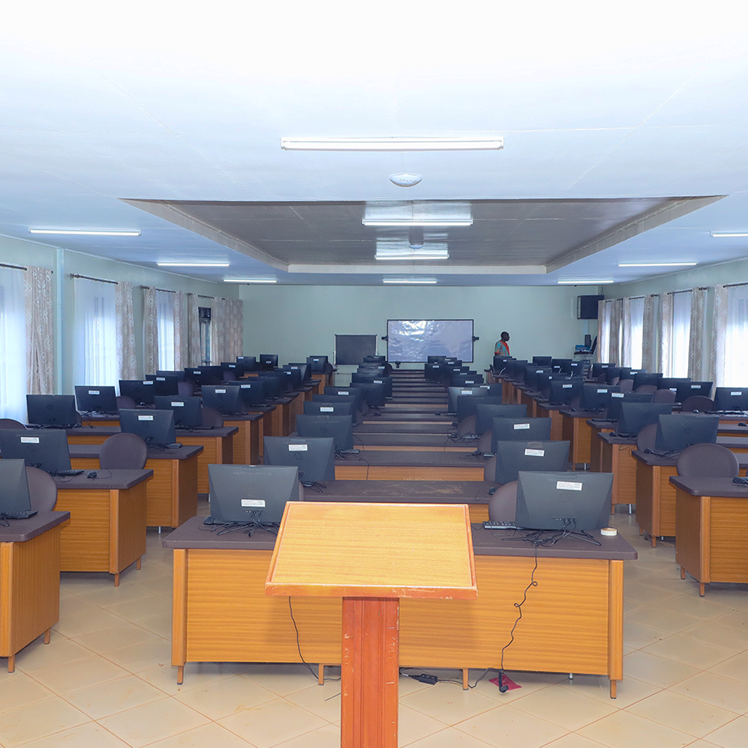
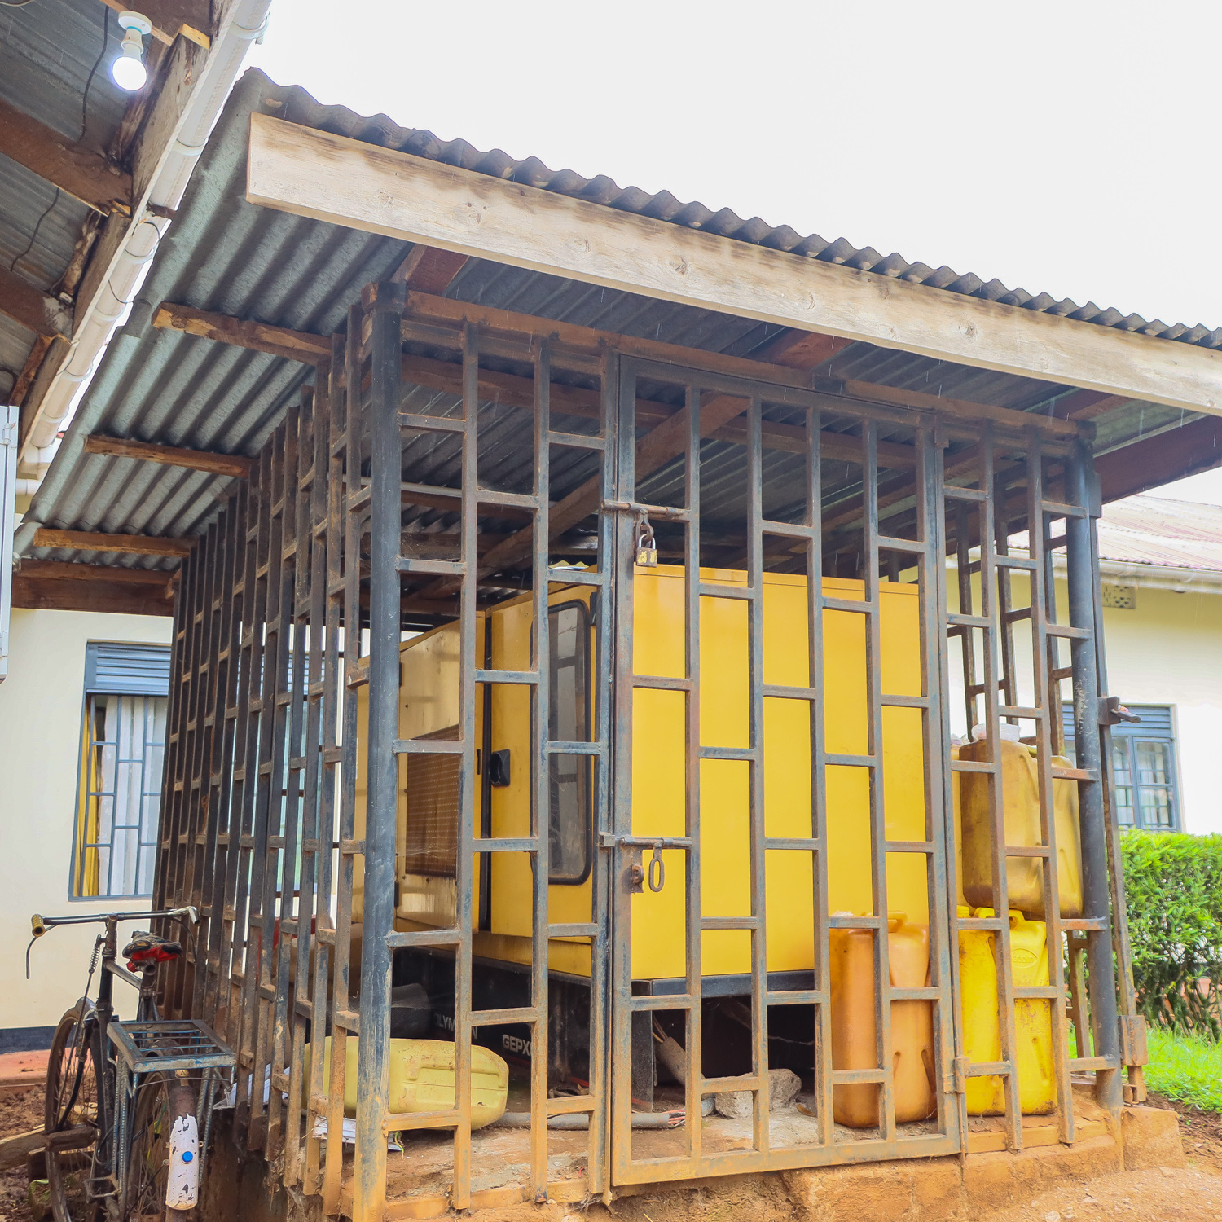
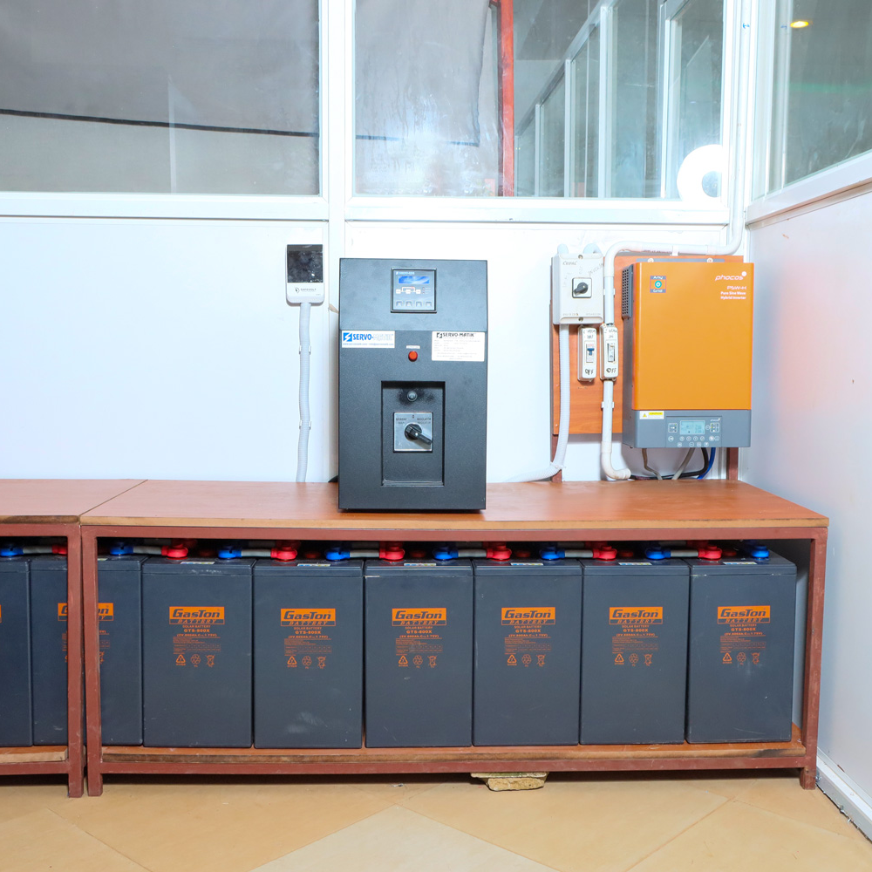
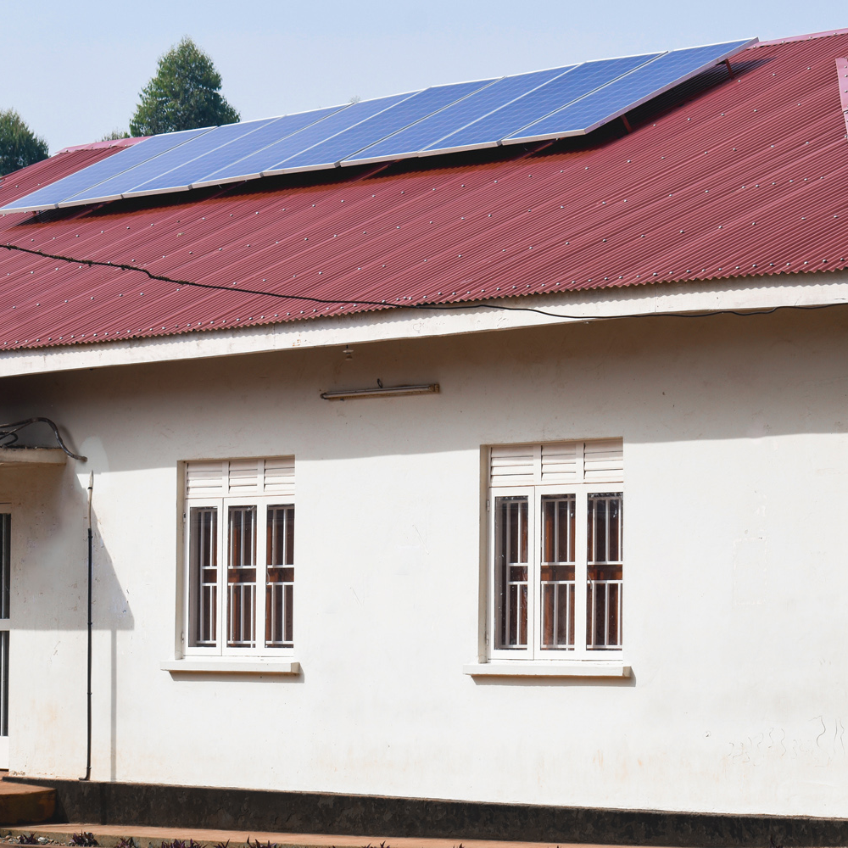
Physical Infrastuctre
200+ user capacity computer laboratories
Four physical libraries i.e., Main, KABSOM, Mukombe and Nyabikoni.
E-learning studio-Donation from world bank, UNDP, C-Code Project
3 stand-by generators that cover all campuses-Efficiency still lacking, Umeme!!! Challenge“!!!
Solar system at the data centre,main computer lab for power backup (72 hours) and 10 hours respectively
State of the art server: E-Learning, and IDR

Slide 10
Computer Laboratories
Name | Number. of Computers | Internet connection | Computer Specifications
Computer lab One (Main campus) | 100 | Wired & WIFI | All in one Desktops (Core i5,8Gb,512Gb)
Computer lab Two (Main campus) | 10 | Wired | Desktop computers (Core i3,4Gb,500Gb)
Computer lab Three (Main Campus) | 15 | Wired | Desktop computers (Core i3, 4Gb,500Gb)
Computer Lab Four (Engineering campus)-Improvment | 20 | Wired | Desktop computers (Core i3,4Gb,500gb)
ICT Innovation Hub (Main campus) | 20 | Wired | Desktop computers (Core i5,8gb,500Gb)
Computer Lab Five (KABSOM) | 15 | Wired | Desktop computers (Core i3,4Gb,500gb)
Main Library | 30 | Wired | Desktop computers (Core i3,4Gb,500gb)

Slide 11
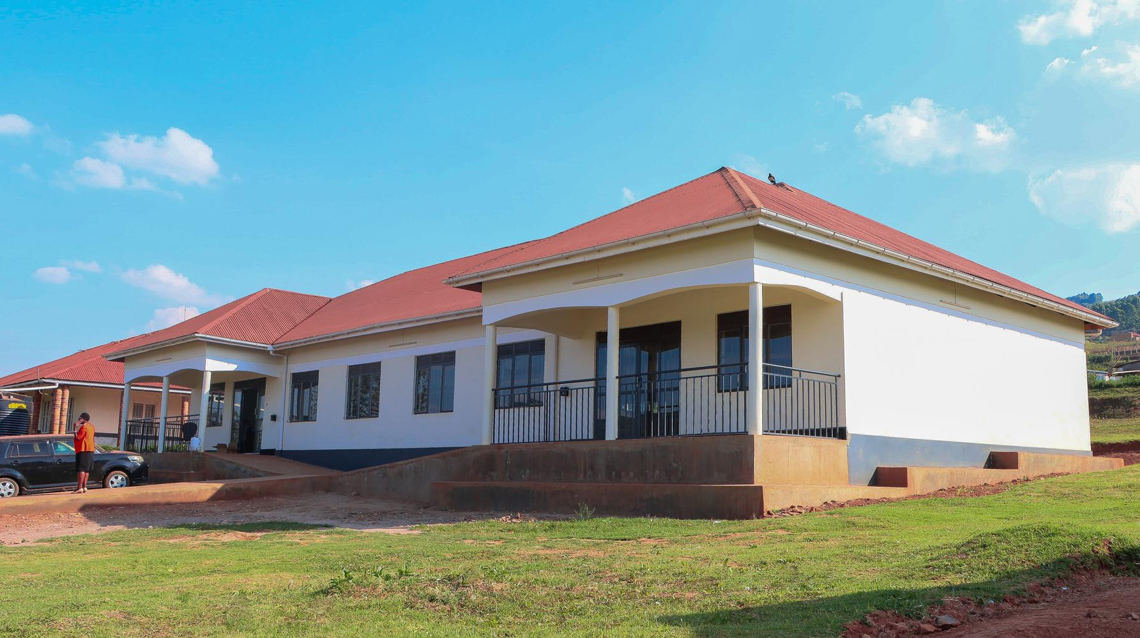
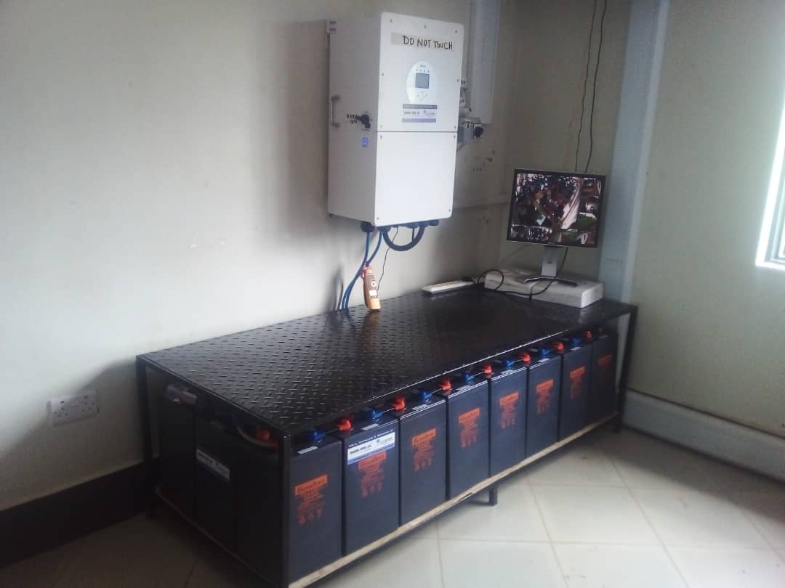
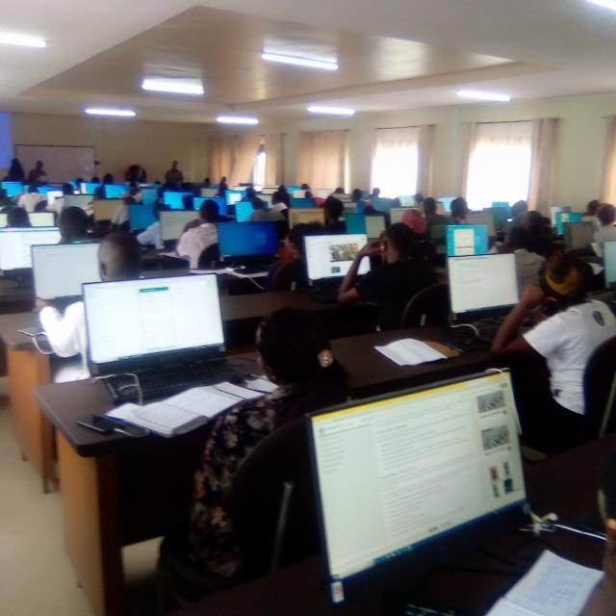
New Computer Laboratory-Operational

Slide 12
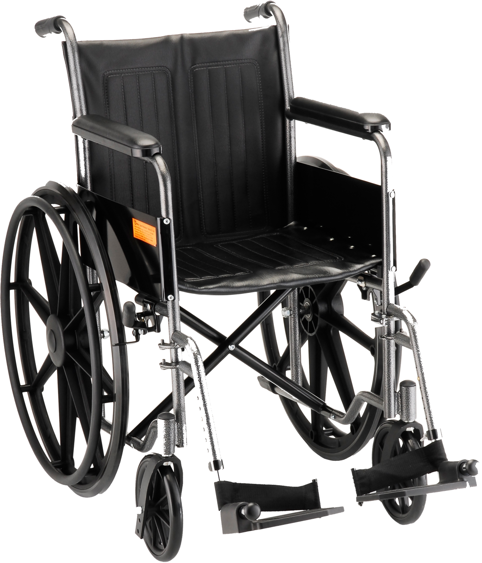
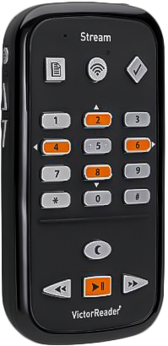
PWDs Readiness & Equipment by University Library
University has 17 students (13 male and 4 females) with special needs i.e., 8 physical disabilities, 1 little person, 2 amputees, 2 visually impaired, 1 hearing impairment (low hearing), 1 person without teeth and 1 with multiple sensory issues.
Special consideration often made during creation of video tutorials e.g., use of sub titles as seen here -> https://youtu.be/hEsPWGiHSis
Ramps often constructed on most buildings
Devices for PWDs procured by Library Dept e.g., 1 Victor Reader. 3 Pro Scanners, and 3 headsets.
Special software was acquired i.e., 3 licenses for Screen reader software (JAWS).
Kab also possesses 6 Braille version copies of the Uganda Constitution.
Need for embosser & precision reader (yet to be purchased)

Slide 13
THE KAB ONLINE SYSTEMS
E-services at Kabale University and other services

Slide 14
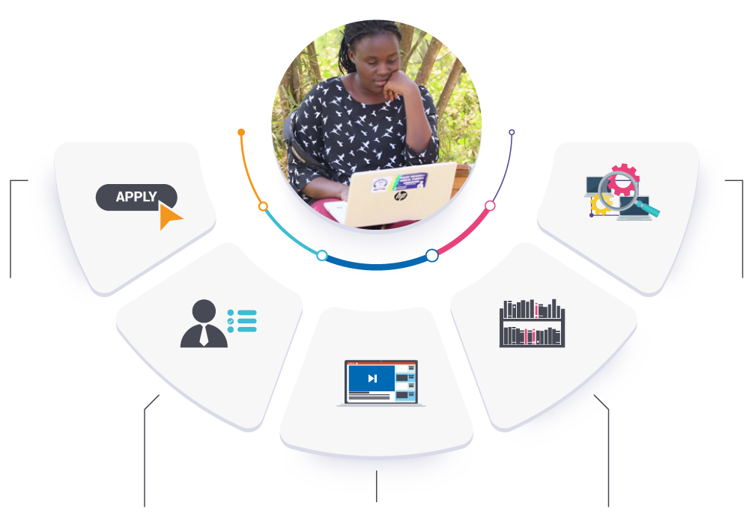
Other supporting Systems
HCM
IFMS-extended
ID processing
E-LEART
QAS-in progress
Online recruitment-in progress
Inventory mgt-in progress
R&P reporting tool-proposed
AIMS: ADMISSIONS
The admissions portal can be accessed via admissions.kab.ac.ug
FACILITIES
Internet connectivity
Computer labs
State-of-the-art servers
Virtual Student Helpdesk
E-learning studio
Power back-up
AIMS:STUDENT INFO MGT
The student’s portal can be accessed via student.kab.ac.ug
Staff portal accessed on staff.kab.ac.ug
E-LIBRARY
In addition to 4 physical libraries, the university also offers an electronic alternative which can be accessed via library.kab.ac.ug
ONLINE LEARNING
KAB utilizes a Moodle-based LMS called the Kabale University Virtual Learning Environment (KABVILE). It can be accessed via elearning.kab.ac.ug
Notes:
The KAB Student E-ecosystem

Slide 15
KAB Online Platforms
Tools | Description
https://elearning.kab.ac.ug | Houses all the learning resources for staff and students. PDF, Video, PPT, Audio, urls, Quizzes etc..
https://esp.kab.ac.ug | The elearning support portal is an extensive knowledge base that Offers self-help services on e-learning related tasks for students and staff
https://helpdesk.kab.ac.ug | Helps organize student & staff communication and helps for quick and effective response.
https://student.kab.ac.ug | Student portal for students i.e, enrollments, payments, marks etc.
https://admissions.kab.ac.ug | Admissions portal for prospective students
https://conferencing.kab.ac.ug | For real-time online classes.
http://elert.kab.ac.ug | Monitoring of lecturer and student online activity. Also helps for monitoring of Exams and adherence.
https://library.kab.ac.ug https://opac.library.kab.ac.ug | Gateway for E-resources and other library related information.
staff.library.kab.ac.ug | Used by library staff to process information resources into the library system
Kabvile Mobile – Google PlayStore | Mobile version of the LMS.
skills.kab.ac.ug | Used to access skills competence using online pre-test interviews

Slide 16

E-library and other Services
Remote Access
For off-campus access to books.
app.myloft.xyz
Open Access
Search massive online databases for papers.
https://library.kab.ac.ug/eresouces/open-access-resources
E-Resources
Find more online resources.
library.kab.ac.ug/electronic-resources/
Catalogue
Find books, media, journals & more.
opac.library.kab.ac.ug
KAB-IDR
Explore vast collection of university research works.
https://idr.kab.ac.ug/

Slide 17
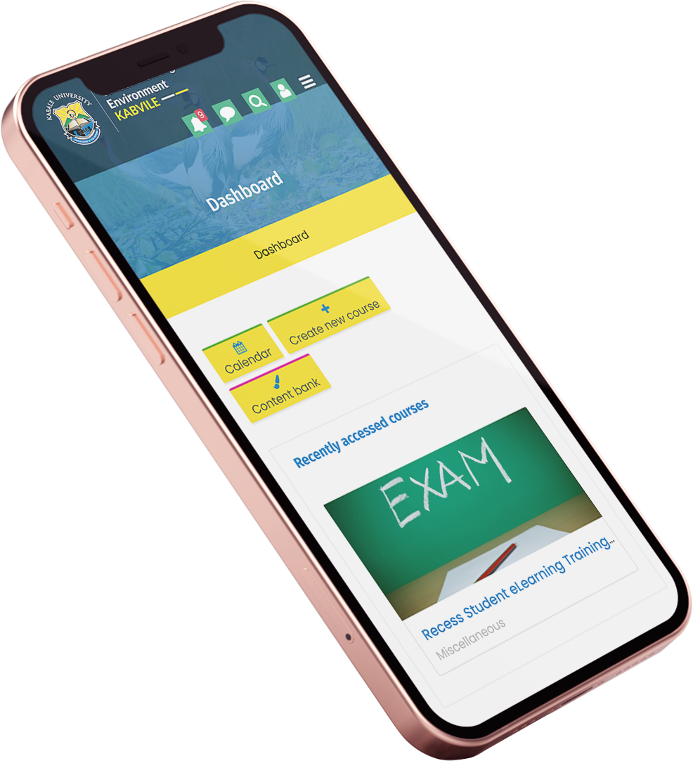
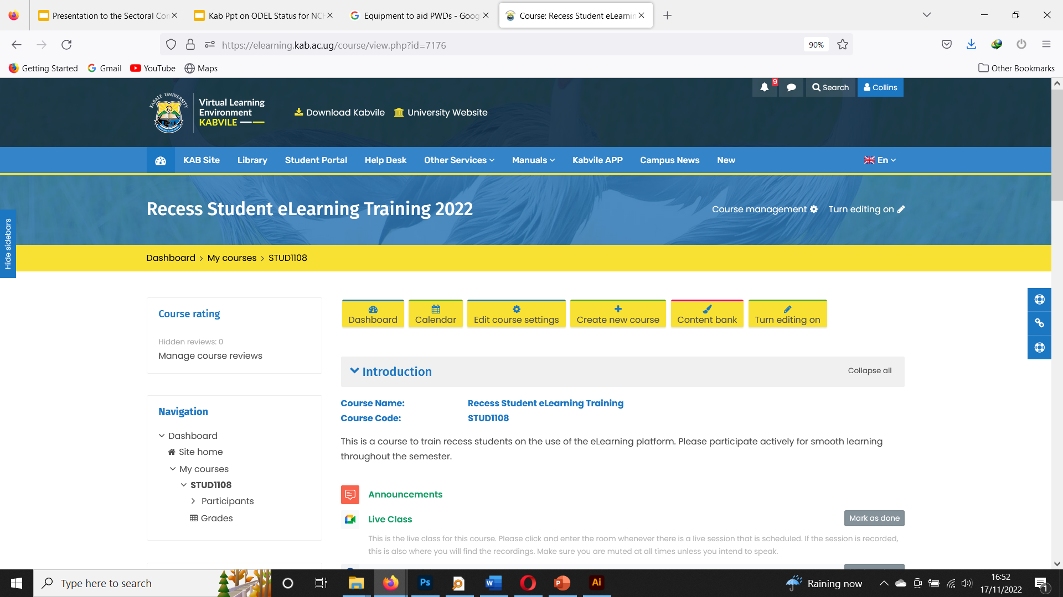
Web and Mobile Learning

Slide 18

LMS and Integrated Services
Address: https://elearning.kab.ac.ug
Platform: Web and Mobile Supported
Framework: Moodle based LMS
No. of Users: 9500+ accounts
Resources & Activities:
Live Classes : Google Meet and Zoom-every faculty
Study Content: Text (PPT, PDF), Video, Audio, Links, etc.
Quizzes: Support a variety of question types, and grades automatically, with the exception of the Essay question type, which needs to be graded by human markers.
Assignments: Essays, Take-home / Open Book Exams and Case Studies.
Other Integrations: Turn-it-in, BigBlueButton, E-LERT etc.

Slide 19

Governance committees and Policies
Committees
ICT and Library Services committee
E-learning committee
Quality Assurance committee
Finance, Planning and Resource Mobilization Committee
Audit and Risk Management Committee
Policies
ICT Policy -2020
E-Learning policy,2020
ODel Policy-2023

Slide 20
Thank You | Asante | Mwebare

