Slide 1
Research/Publications & Grant writing
Presentation to the Heads of Departments, KABSOM
18-19 April 2024

Slide 2
Content
Introduce the Directorate of Research and Grants
Outline how we work together
Explore some sources of funding available to all departments

Slide 3
Directorate of Research and Grants (DRG)
The mandate of DRG is to harmonize and coordinate research and publication activities at the University.
Roles, we contribute to:
create an environment and culture of research and innovation
mobilise resources for research and innovation
disseminate research outputs and innovations
build partnerships with donors, industry, communities and researchers to promote RI

Slide 4
Directorate of Research and Grants (DRG)
Governance of the Directorate of Research and Grants Directorate.
Research and Publications Advisory Board (RPAB)
Research Technical Review Committee (RTRC)
Faculty/School/Institute Research and Publication Committees (FRPC)

Slide 5
1. Create an environment and culture of research and innovation
Notes:
Through policies and frameworks

Slide 6
Develop and promote policies and strategies for RI
Research Agenda
Research and Innovation Strategic Plan 2021-2025
Research and Innovation Policy
Intellectual Property Policy
KAB Research Ethics Committee
Notes:
We do not do research, but contribute to drive research in the university
Value of research:
creating knowledge needed for teaching and learning;
Developing knowledge for influencing development policy;
Developing innovations contributing to national, regional, and international development
Improving KAB ranking, which is essential for attracting human and financial resources
Research and resulting publications determine how far you go with your careers
Additional income to self, university, local government and and nationally
of HEIsThere is sufficient evidence indicating that universities with a clear research roadmap, increased investments in research, and increased research outputs
have a higher potential for growth.

Slide 7
KAB- Research Agenda
The roadmap for research and innovations at KAB as a contribution to the KAB Strategic Plan 2021 – 2025 - SO5: Strengthen research, innovation and publication capacity of the University
Developed through a bottom up approach based on the interests of the faculties and guidance from KAB and national strategies
Objective is to increase the production of relevant and impactful knowledge and services through research and innovations that can contribute to the wellbeing of society.
Captures 14 Thematic Areas of research that are prioritized in Research and Innovation efforts

Slide 8
KAB-Research and Innovations strategic plan
Purpose “To increase the Number and Impact of Research and Innovations at Kabale University as a means of Demonstrating its Relevance to society”.
Pillars:
Building and strengthening staff and students’ capacity for research
Increasing resources for RI from both domestic and external sources.
Building strong, resilient and productive RI collaborations.
Improving the infrastructure and environment for research and publications.
Promotion of multi-disciplinary research.
Notes:
Aligned to University strategy 2021-2025

Slide 9
Research and Innovation Policy
The purpose of the policy is to strengthen the research and innovation ecosystem of KAB and increase its contribution to the national and global knowledge and innovation economy.
Covers 14 Policy Areass including Governance, funding, ethics, integrity, discrimination etc.
Clarifies processes and procedures for Implementation, Monitoring and Evaluation, and Review of the Policy

Slide 10
Intellectual Property (IP) Policy
Deals with the ownership, commercial and social exploitation and distribution of the benefits accruing from commercialized IPs created at KAB.
Highlights key principles for the conduct of RI at KAB, such as Academic freedom and fair benefication
Provides mechanisms for management of IPs covering ownership, commercialization and benefit sharing

Slide 11
KAB-Research Ethics Committee
All research in Uganda must be approved by an accredited Research Ethics Committee (REC), and posses a permit issued by the Uganda National Council for Science and Technology (UNCST)
KAB University has its own REC advising and providing a quality control measure for research and innovations from Kabale University and beyond.
KAB-REC constituted with participation by external representatives, including the Chair.

Slide 12
2. Mobilise resources for research and innovation
Notes:
Through policies and frameworks

Slide 13
Internal funding
KAB University Council allocates funding for research in faculties and the DRG.
DRG administers these funds, including a 1 billion Research and Innovation Fund
Available for teams – KAB Researchers of different levels, students, other collaborators
Continuously open call for proposals and decisions made on a quarterly basis

Slide 14
External funding
KAB staff apply for funding from external sources (not allocated by University Council)
All staff can contribute – Management, Administrative, Academic and Students
DRG supports subscription to a database for identifying funding sources (Funds Beeline); training in grant writing; tracking progress
DRG can also lead or support specific initiatives to mobilise funds

Slide 15
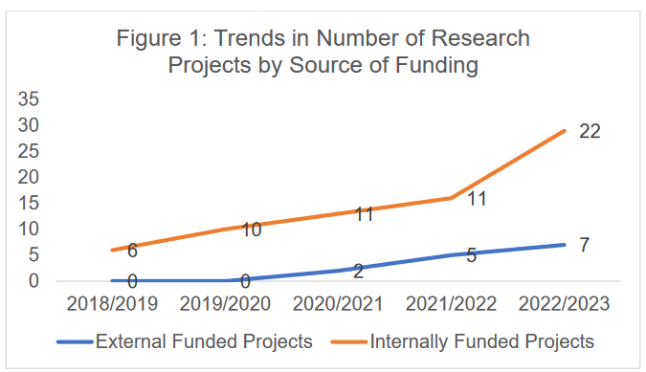
Research funds by source

Slide 16
3. Disseminate research outputs and innovations
Notes:
Through policies and frameworks

Slide 17
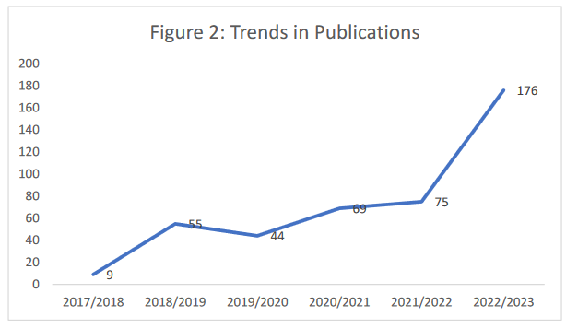
Tracking publications outputs

Slide 18
Publication of KAB Research Journals
African Journal of Governance and Public Leadership (AJoGPL) - quarterly journal for Public Administration, Management, Governance, Public Policy, Public Leadership and related fields.
Kabale University Interdisciplinary Research Journal (KURJ)
multidisciplinary journal accepting high quality original research articles, letters and commentaries
Accessible for promoting KAB RI.

Slide 19
Research Dissemination workshops
Support Faculties in research dissemination
FASS – Dissemination seminar 14th June 2024, call for proposals – announcement today
FOS – African Women Workshop in Algebra 1-5 July 2024

Slide 20
4. Build partnerships with donors, industry, communities and researchers to promote RI
Notes:
Through policies and frameworks

Slide 21
RI Strategic plan - objective 5
Partnership projects e.g. NISHATI partnership project funded by the EU Erasmus+ Fund – 10 universities including KAB; Cambridge Conservation Initiative; UNDP, University of Exeter,
Attendance of conferences and donor meetings; European Union Delegation, Mountains of the Moon University

Slide 22
How we work together
Notes:
Through policies and frameworks

Slide 23
Faculty Research and Publication Committees
Represented on the Research and Publications Advisory Board
Contribution to the Research Technical Review Panel
Feed information on Research, Innovations and Dissemination plans
Represented on KAB-REC

Slide 24
Individual contacts
Apply for grants from Internal Funds
Build teams to apply for external grants – ask for support in terms of tools, information, contacts
Inform DRG of the outcomes of your fundraising efforts
Share with DRG your publications
Request and participate in training and capacity building

Slide 25
Explore a source of funding available to all departments
The Erasmus+ programme of the European Union
Notes:
Through policies and frameworks

Slide 26
What is it?
The EU's programme to support education, training, youth and sport
Funding for programmes, projects and scholarships
Fosters EU-EU and EU-international cooperation
International projects
Are based on partnerships
Meet a need at your institution / in your country

Slide 27
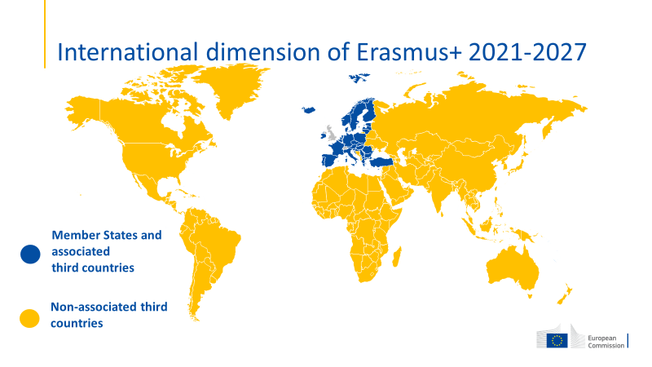

Slide 28
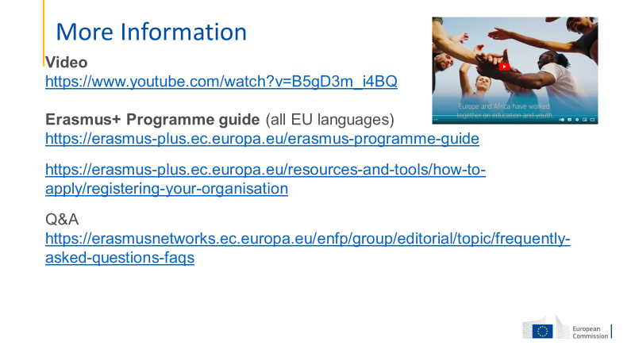

Slide 29
Main funding lines available to KAB
International Credit Mobility
Erasmus Mundus: Joint Masters and Design Measures
Capacity Building in Higher Education (CBHE)
Earmarked Euro 570 million for 2021-2027, 49% of it to International Mobility Project; 28% to Capacity building in higher education and 8% to Joint Masters.
Calls coming in November 2024 with deadlines in February 2025

Slide 30
1. International credit mobility
Message to Universities:
“Begin to engage with European partner universities able to apply”
Message to students:
“only possible if your university has an agreement with a European one”
MAIN FEATURES
Short-term higher education mobility for students, academic and administrative staff
All levels: Bachelor, Master and PhD candidates for African students (only staff and PhD candidates from Europe to Africa)
Mobility in any subject or academic discipline
Duration: 2-3 years projects
Also supports traineeships for students and training for staff
Study periods and traineeships of 2 – 12 months (5 days to 2 months for staff)
Blended mobility (physical mobility of 5 – 30 days + virtual component)
Notes:
International credit mobility projects are based on bilateral agreements between universities in Europe and universities in other parts of the world. They agree to send and host each other's students and staff.
These agreements can move students for study, students for traineeships, and staff.
Mobility can be in either direction.
The projects are proposed by European universities.
Each European country will have a budget for its universities to fund mobility agreements with scholarships for all regions of the world. European universities apply to their national agencies.
The funding covers:
Living costs for individuals
Contribution to travel costs for individuals
An ‘operating cost’ allowance per invidual paid to the partnership to cover the costs of running the partnership.
There are no fees covered in the grant – the two sides agree to waiver any participation costs.
Universities in non-associated third countries (outside Europe) should therefore talk to the European academic contacts they have about planning mobility with Erasmus+
Each European country will have budget to cooperate with each part of the world.

Slide 31
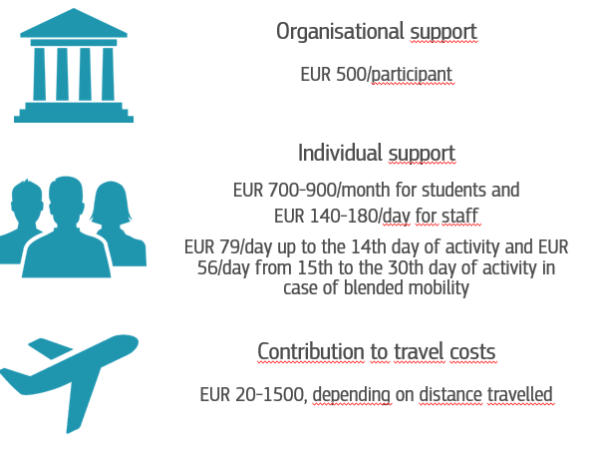
International Credit Mobility in practice
The applicant is a higher education institution in Europe
This action is managed by the Erasmus+ National Agency where the applicant is located
The European University and its partner institution in a non-associated country sign an inter-institutional agreement.
A grant agreement links the European University and its E+ national agency.
A learning learning/mobility agreement links the participant to the sending and hosting institutions.

Slide 32
Urgent next steps
Do you have a need for capacity building that can be addressed through an exchange programme with a European University?
Do you know a person/people in an EU or associated third country able to co-develop a project with you?
Read the guidelines to Erasmus, look at the FAQs, look at reports of previous projects.
If you are interested, let us know (chief-drg@kab.ac.ug) and we will journey with you.

Slide 33
Thank you!
Thoughts? Suggestions?
chief-drg@kab.ac.ug

