Slide 1
Directorate of Quality Assurance
Quality Assurance in Universities: The Role of Faculties and Departments

Slide 2
Overview
What is Quality?
What is Quality Assurance?
Why Quality Assurance?
What is the Role of Faculties/Departments in Quality Assurance?
Handling Academic Programme Development/Review

Slide 3
1. What is Quality?
What is Quality?
There are as many definitions of quality as the number of stakeholders: Government, Employers, Academic World, Students, Parents (Sponsors) and Society at Large.
Each stakeholder has its requirements.
IUCEA Handbook for Quality Assurance in HEIs, vol. 1 &2

Slide 4
1. What is Quality?
What is Quality?
Harvey and Green (1993) categorized quality as follows:
1. Quality as exceptional or excellence: Something special or of high standard. For example: What is the quality of our academic programmes, publications, etc.
Quality as excellence: Excellence can be conceived of as 'doing the right things well’. The notion of centres of excellence in higher education is hinged on this view.
2. Quality as perfection or consistency: Quality is one which conforms exactly to specification and whose output is free of defects at all times.

Slide 5
1. What is Quality?
What is Quality?
3. Quality as Fitness for Purpose: Quality is judged in terms of the extent to which the product or service fits its purpose. Key question: Is the institution/Faculty/Department meeting its vision, mission, objectives and standards.
4. Quality as value for money: Focuses on efficiency, measures output against input.
5. Quality as transformation: Transformative education is one that effects changes in the participants and attempts to empower students for life after college. Changes must occur as a result of education.

Slide 6
2. What is Quality Assurance?
What is Quality Assurance?
NCHE- “The mechanism put in place to guarantee that the education is ‘fit for purpose,’ i.e., is good.
The means by which an institution can guarantee that the standards and quality of its educational provisions are being maintained and/or enhanced (teaching, research and community engagement).
NCHE requires that every institution must have appropriate and effective internal structures and mechanisms for monitoring its institution quality control procedures to ensure quality.

Slide 7
3. Systems of Quality Assurance
Systems of Quality Assurance
There are two major types of Quality Assurance systems:
External Quality Assurance: Is the one carried out by an external body, usually, a regulatory agency, professional bodies. This is mainly for programme and institutional accreditation.
Internal Quality Assurance: Internal Quality Assurance is the process through which an institution carries out a quality assurance process within its system with the purpose of ensuring that it is delivering excellent services. E.g. Internal moderation of examinations, external examination, programme evaluation, students evaluation of teaching and learning, etc.

Slide 8
4. Why Quality Assurance
Factors Compelling Quality Assurance
Involvement of private interests in higher education:
MUK was the only degree awarding institution in Uganda until 1988 when the organisation of Islamic Conference created IUIU as first private university.
According to NCHE 2020/2021 Report on the HE Delivery and Institutions, the number of HEIs were 246 (9 public universities, 48 private universities, 19 Other degree awarding institutions and the rest OTIs).
Expansion in Enrolments:
Institutions of HE are under increasing pressure to admit more students than their capacity in terms of staffing, equipment, library and laboratory facilities, etc..
Advancement in Technology:
New contextual issues such as electronic delivery of educational services, cross-border delivery and consumption of educational services, skills development outside formal learning arrangements, AIs.

Slide 9
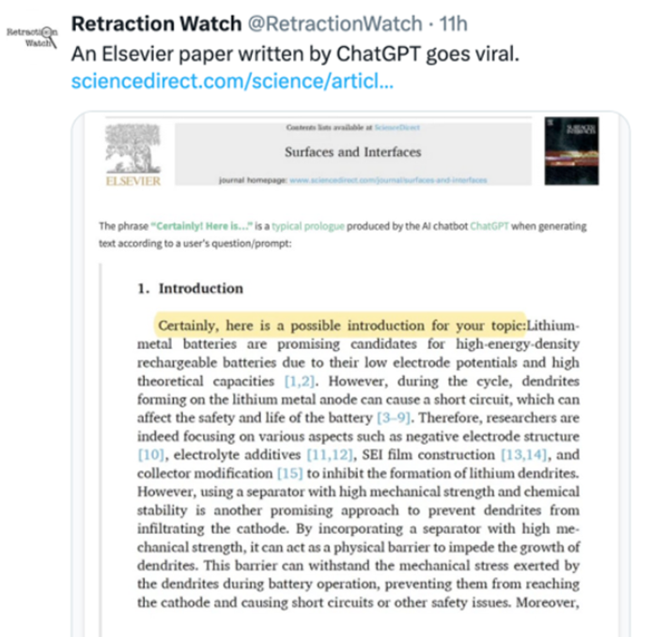
4. Why Quality Assurance
Factors Compelling Quality Assurance
AI in teaching, assessment and publications.
The current situation increases the pressure to make new efforts for student protection both at national as well as international levels.

Slide 10
4. Why Quality Assurance
Factors Compelling Quality Assurance
Market Demand for Quality and Relevance of Education:
We are moving very fast into the era where the end-users of the products of higher education are demanding for relevance and the need for special skills from the products of these institutions.
The Challenge of the Pandemic:
The Covid-19 pandemic has changed the face of higher education. The face-to-face mode of teaching and learning will need to give room to virtual teaching and learning. Many institutions are struggling to provide the necessary infrastructure to conduct learning through the virtual space.
Today, examinations, practical exercises, research and other activities are being facilitated virtually. There is need to ensure that the quality of these modes of delivery meet up to the standards set for such programmes.

Slide 11
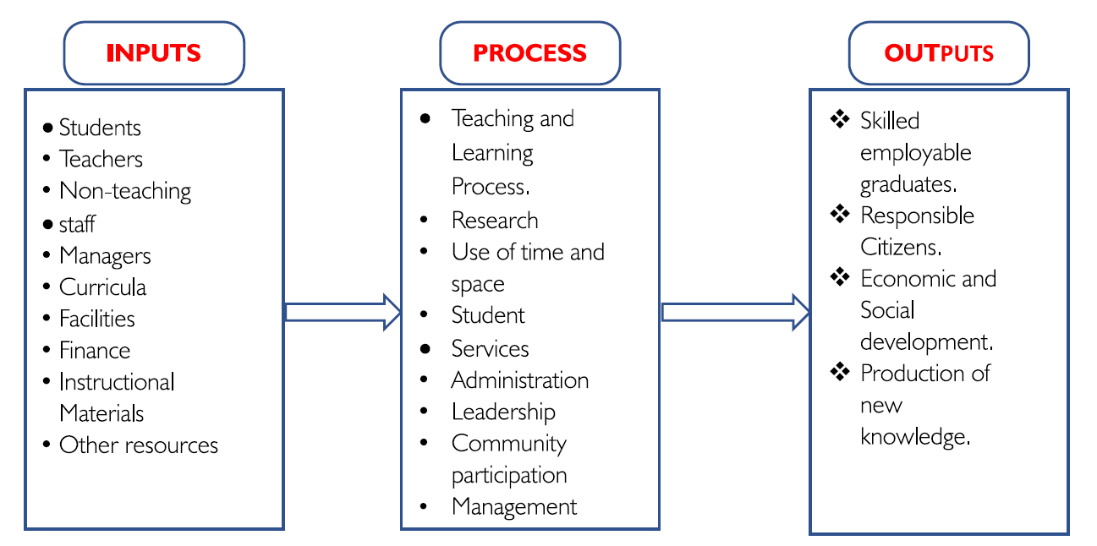
5. Quality Assurance Approach
Quality Assurance Approach
Okebukola (2006) proposed a comprehensive approach to quality assurance, which focus on the dimensions of inputs, process, and outputs.
Quality Assurance of What? (Okebukole, 2006)

Slide 12

5. Quality Assurance Approach
Quality Assurance Approach

Slide 13
6. Functions of a Faculty/Department
Functions of Faculties/Departments in a University
The Quality Assurance policy provides for FQAC and DQAC to handle QA matters at the Faculty and Department respectively.
Monitoring the implementation of the curriculum:
  Students meet the required minimum requirements.
  There is adequate facilities to run the programme.
  The students are taught by qualified staff. Section 119 of the Act provides that “No University or Tertiary Institution shall employ a lecturer, instructor or other person recruited for the purpose of teaching or giving instructions to students whose qualifications do not conform to the NCHE standards.”
  Tracking the accreditation status of the programmes. Submission 6 months before the date for review.
  Moderation of exams, assessment of students.

Slide 14
6. Functions of a Faculty/Department
Functions of Faculties/Departments in a University
Research: Members engage in research activities, including publishing papers, and contributing to advancement of knowledge in their respective fields.
Advising: Members provide academic and career guidance to students, including advising on course selection, research projects, internships, etc.
Curriculum Development/Review: Members participate in the development and review of academic programmes.
Service: Members often serve on committees, task forces, and academic boards within the university.
Community Engagement: Members engage with the local community, industry partners, and other stakeholders through outreach programs, partnerships, and collaborative projects that benefit society.

Slide 15
7. Handing Academic Programmes
Handling Academic Programmes
A programme is a coherent set of courses leading to the attainment of a certain award.
Ideas for the new programme can come from different sources.
It can be the outcome of department ideas, student community requests, strategic planning process, advancement in the discipline or success stories at other universities.
New ideas on the programmes must first be screened and reviewed.
The following questions should be asked and discussed:
Is the proposed programme consistent with and supportive of the Mission, Vision and strategic direction of the University?

Slide 16
7. Handing Academic Programmes
Handling Academic Programmes
Can the proposed programme be delivered by the existing staff?
Is the proposed programme consistent with the strength and core competences of the department? If not, what can be done?
Is the proposed programme free from duplication or competition with a current or other planned programme within the university.
Does the needs assessment indicate that there is an adequate demand for this programme to justify projected programme revenue?
What is the expected net revenue over the projected programme’s direct expenses to be generated by the programme

Slide 17
7. Handing Academic Programmes
Handling Academic Programmes
Is the proposed programme sustainable on a long term basis.
In what format (mode) will the programme be offered e.g. face –to - face, online or blended.

Slide 18
8. Programme Review
Why Review a Programme
To respond to the regulators as a result of programme life cycle, duration is (2n+1), where n is the programme duration.
To evaluate effectiveness of the existing curriculum based on local and external data sources,
To assess the relevancy of the programme,
To align the programme to suit the needs of all stake holders,
To review the correlation between curriculum and assessments,
Identify staff development needs, for example, competence based teaching and learning.

Slide 19
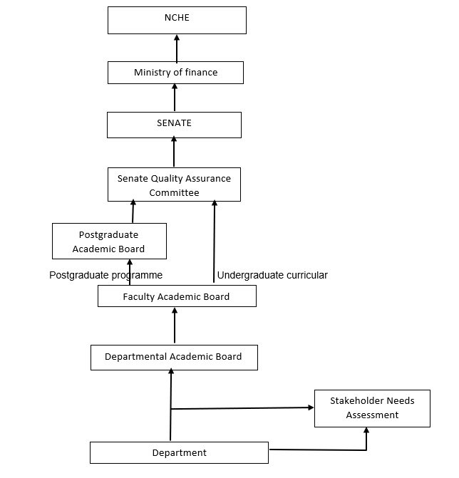
9. Programme Approval Process
Programme approval process

Slide 20
10. Programme Format
Format for the Developed/Reviewed programme
Title page
Table of Content
Background of Kabale University
Name of the Programme and duration
Programme description
Programme Rationale (gaps analysis done, competences identified, nationally, regionally, globally).
Programme development process
Programme objectives
Programme Learning outcomes
Entry / Admission Requirements
Resources available (HR, infrastructure, books, equipments, laboratories, etc,)

Slide 21
10. Handing Academic Programmes
Format for the Developed/Reviewed programme
Programme regulations
Minimum graduation load
Admissible number of students per year.
Curriculum structure
All new program proposals should include the financial analysis/ Budget

Slide 22
Thank you!

