Slide 1
Orientation
Collins Nowamani
cnowamani@kab.ac.ug | +256776348200
Web Administrator (Webmaster)

Slide 2
Internet
Wifi name: KABALE UNIVERSITY
Password: kab@root2023

Slide 3
University Domain
kab.ac.ug
Kabale University.academic.uganda

Slide 4
Sub/Child Domains (…/kab.ac.ug)
Library Website (library.kab.ac.ug)
News Website (news.kab.ac.ug)
Events Website (events.kab.ac.ug)
Gallery Website (gallery.kab.ac.ug)
Elearning (elearning.kab.ac.ug)
…

Slide 5

Our websites run on all platforms

Slide 6
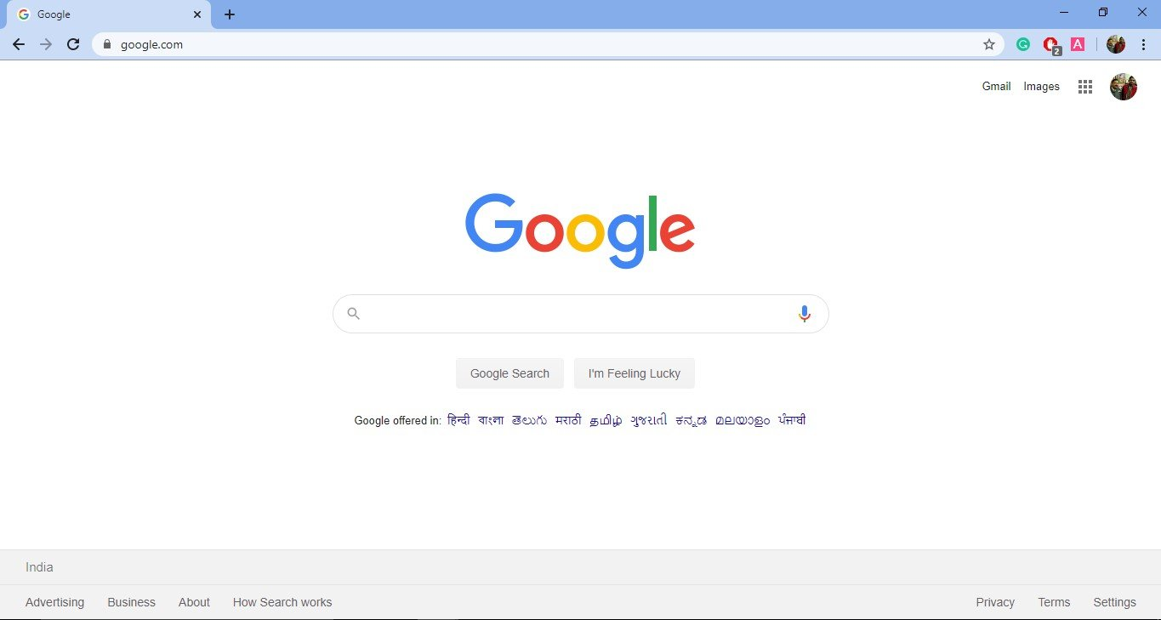
Where to type

Slide 7
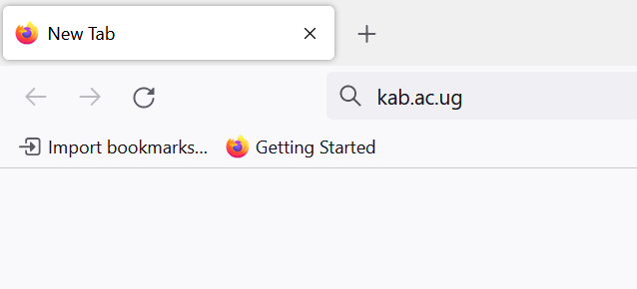
Type kab.ac.ug

Slide 8
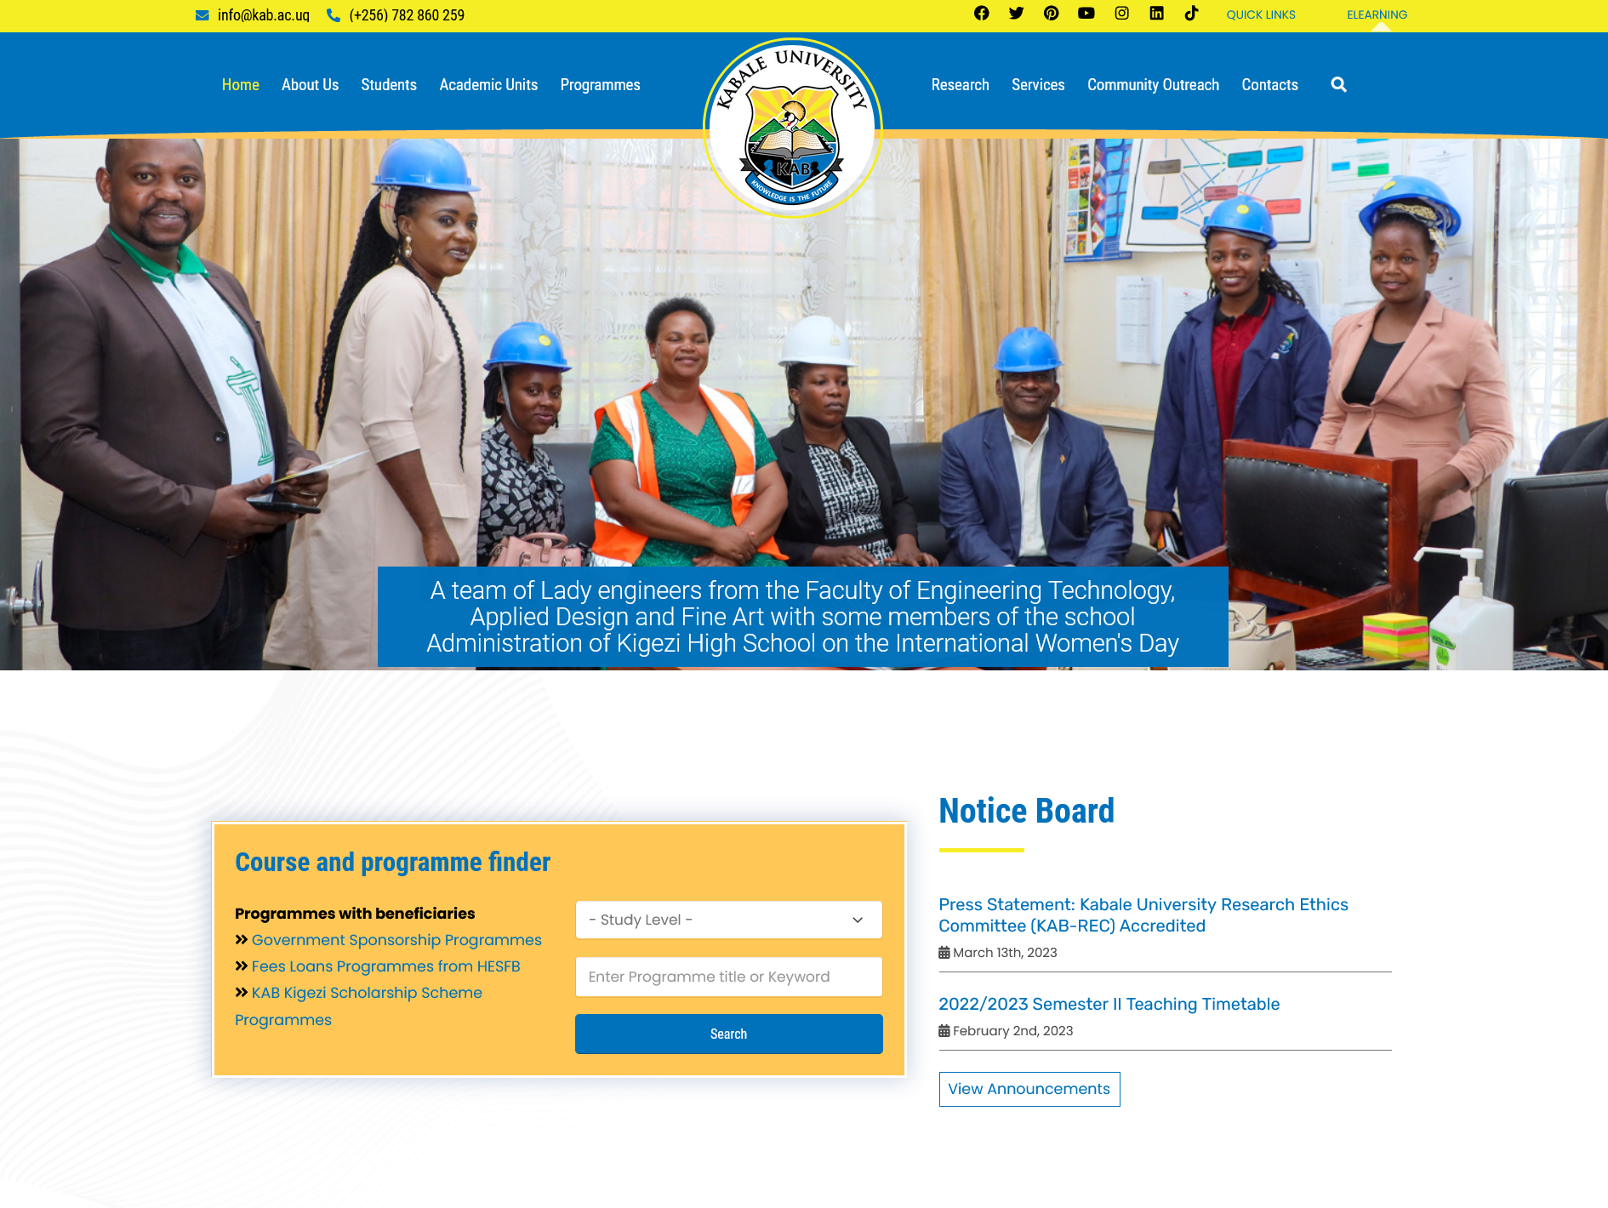
Kabale University Main Website kab.ac.ug

Slide 9
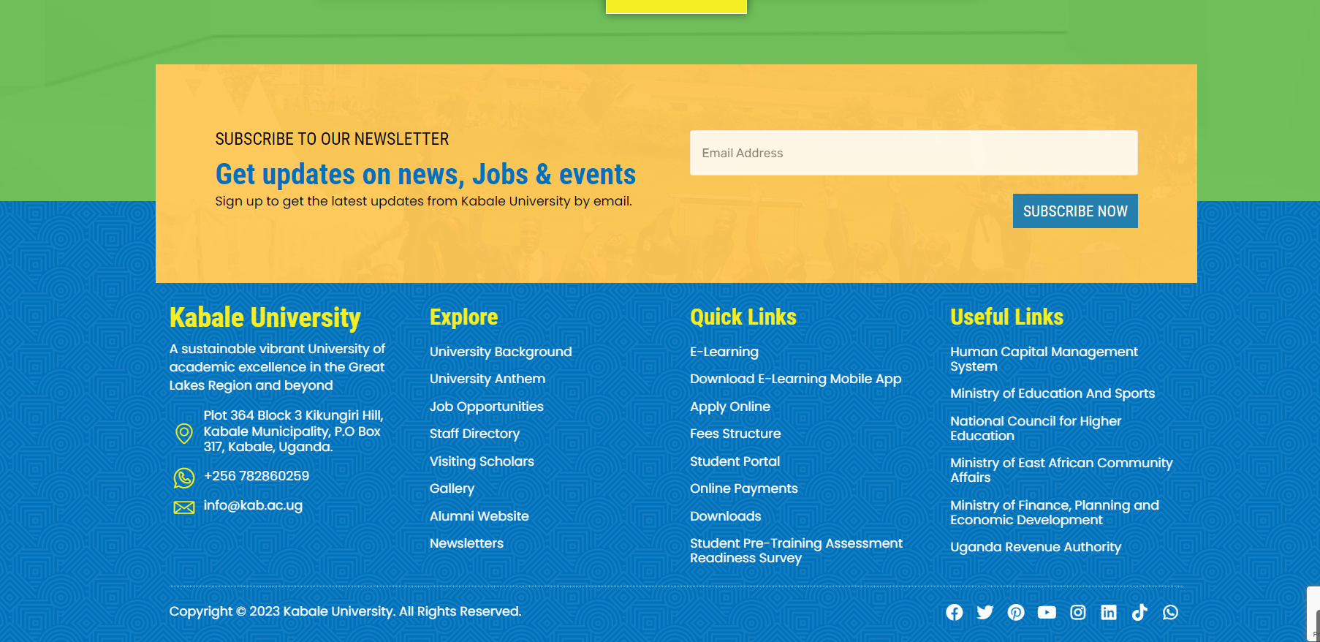
Be the first to Know

Slide 10
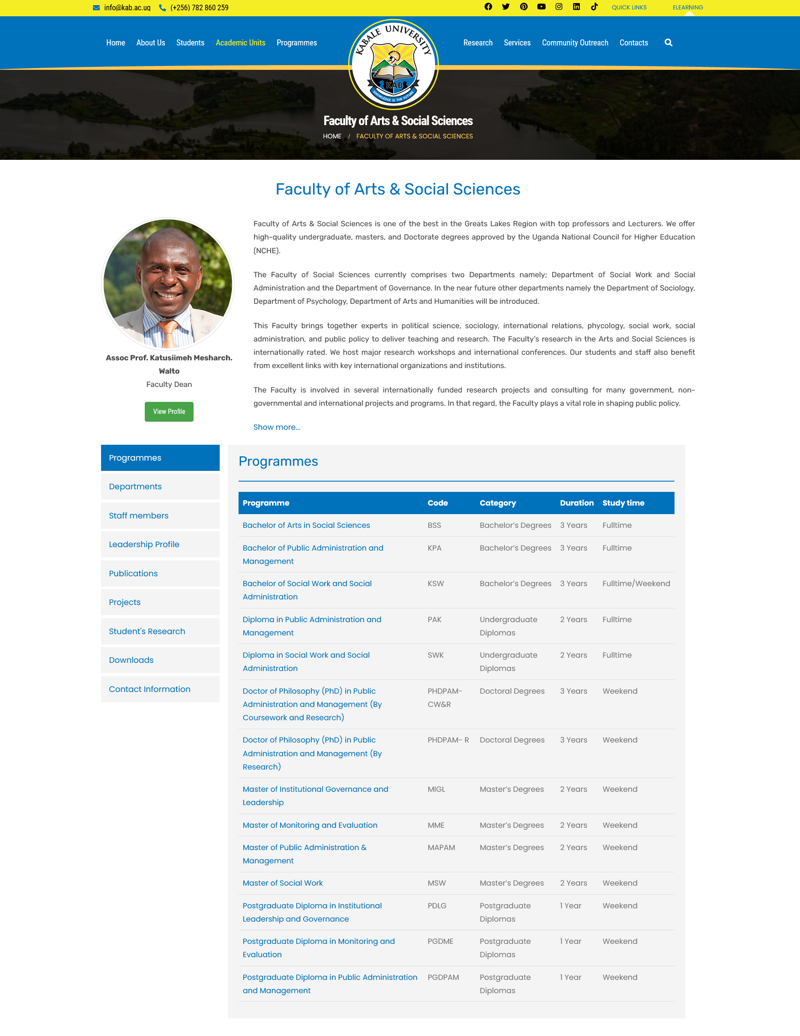
Faculty Profile

Slide 11
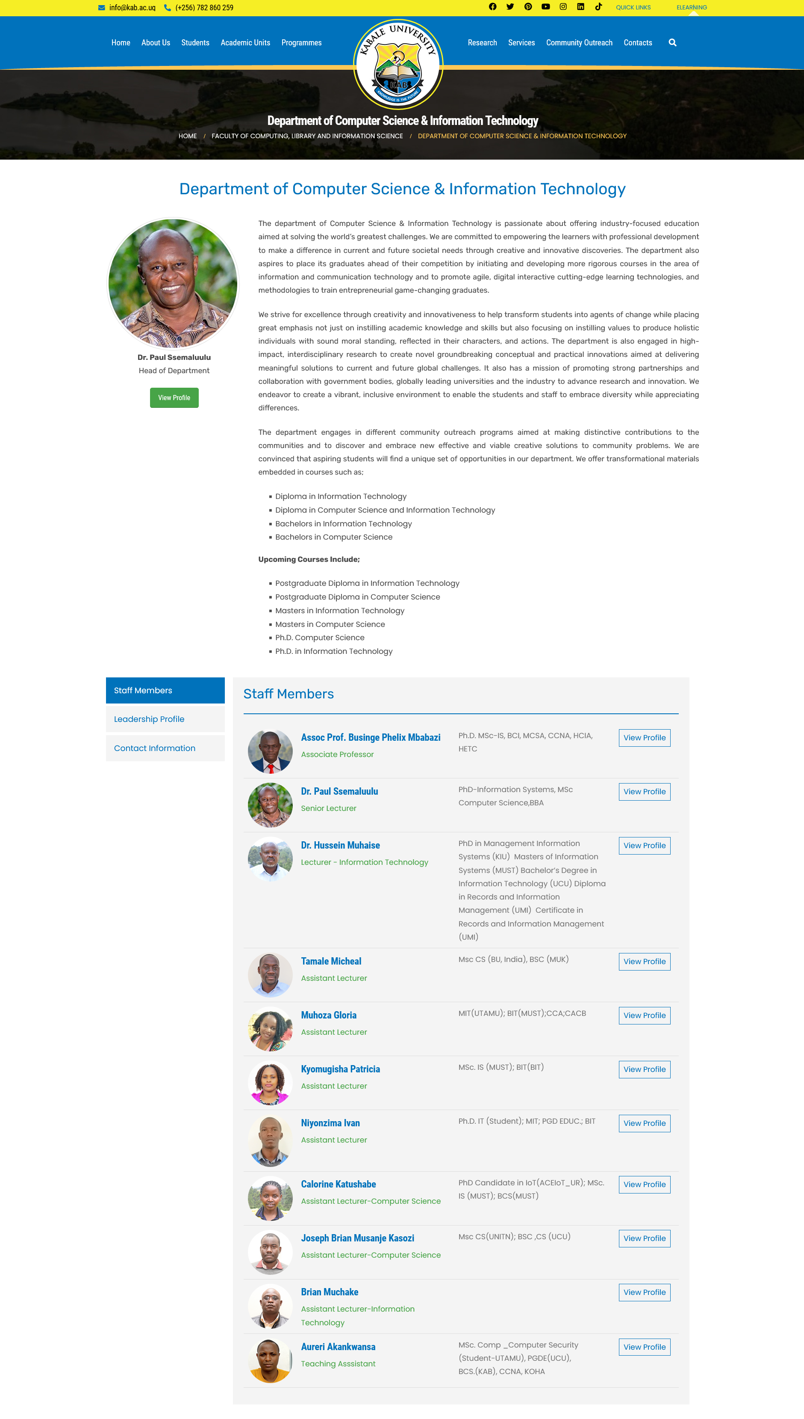
Department Profile

Slide 12
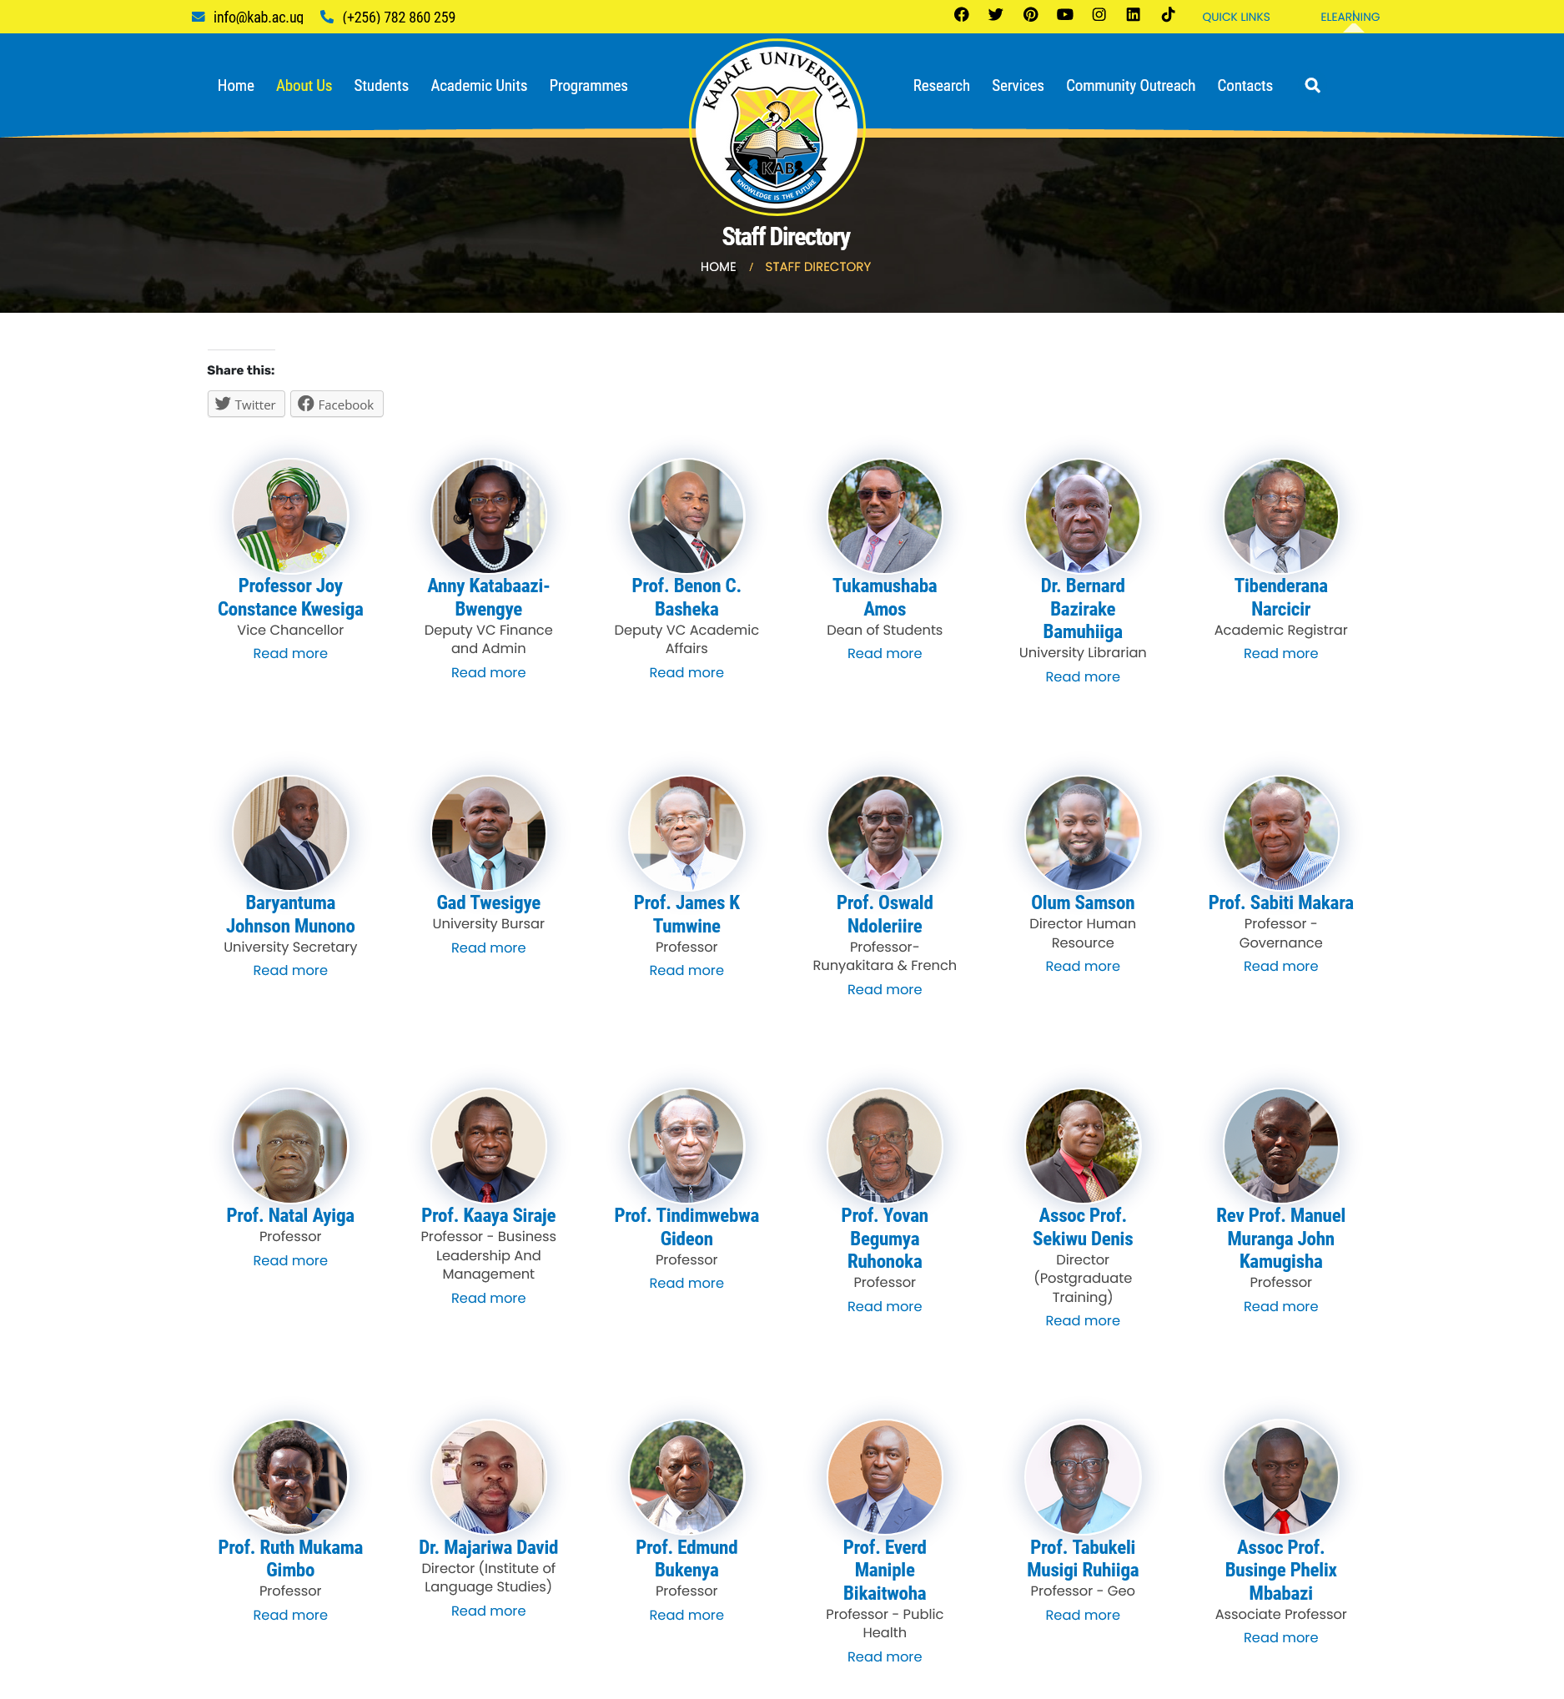
Staff Directory

Slide 13
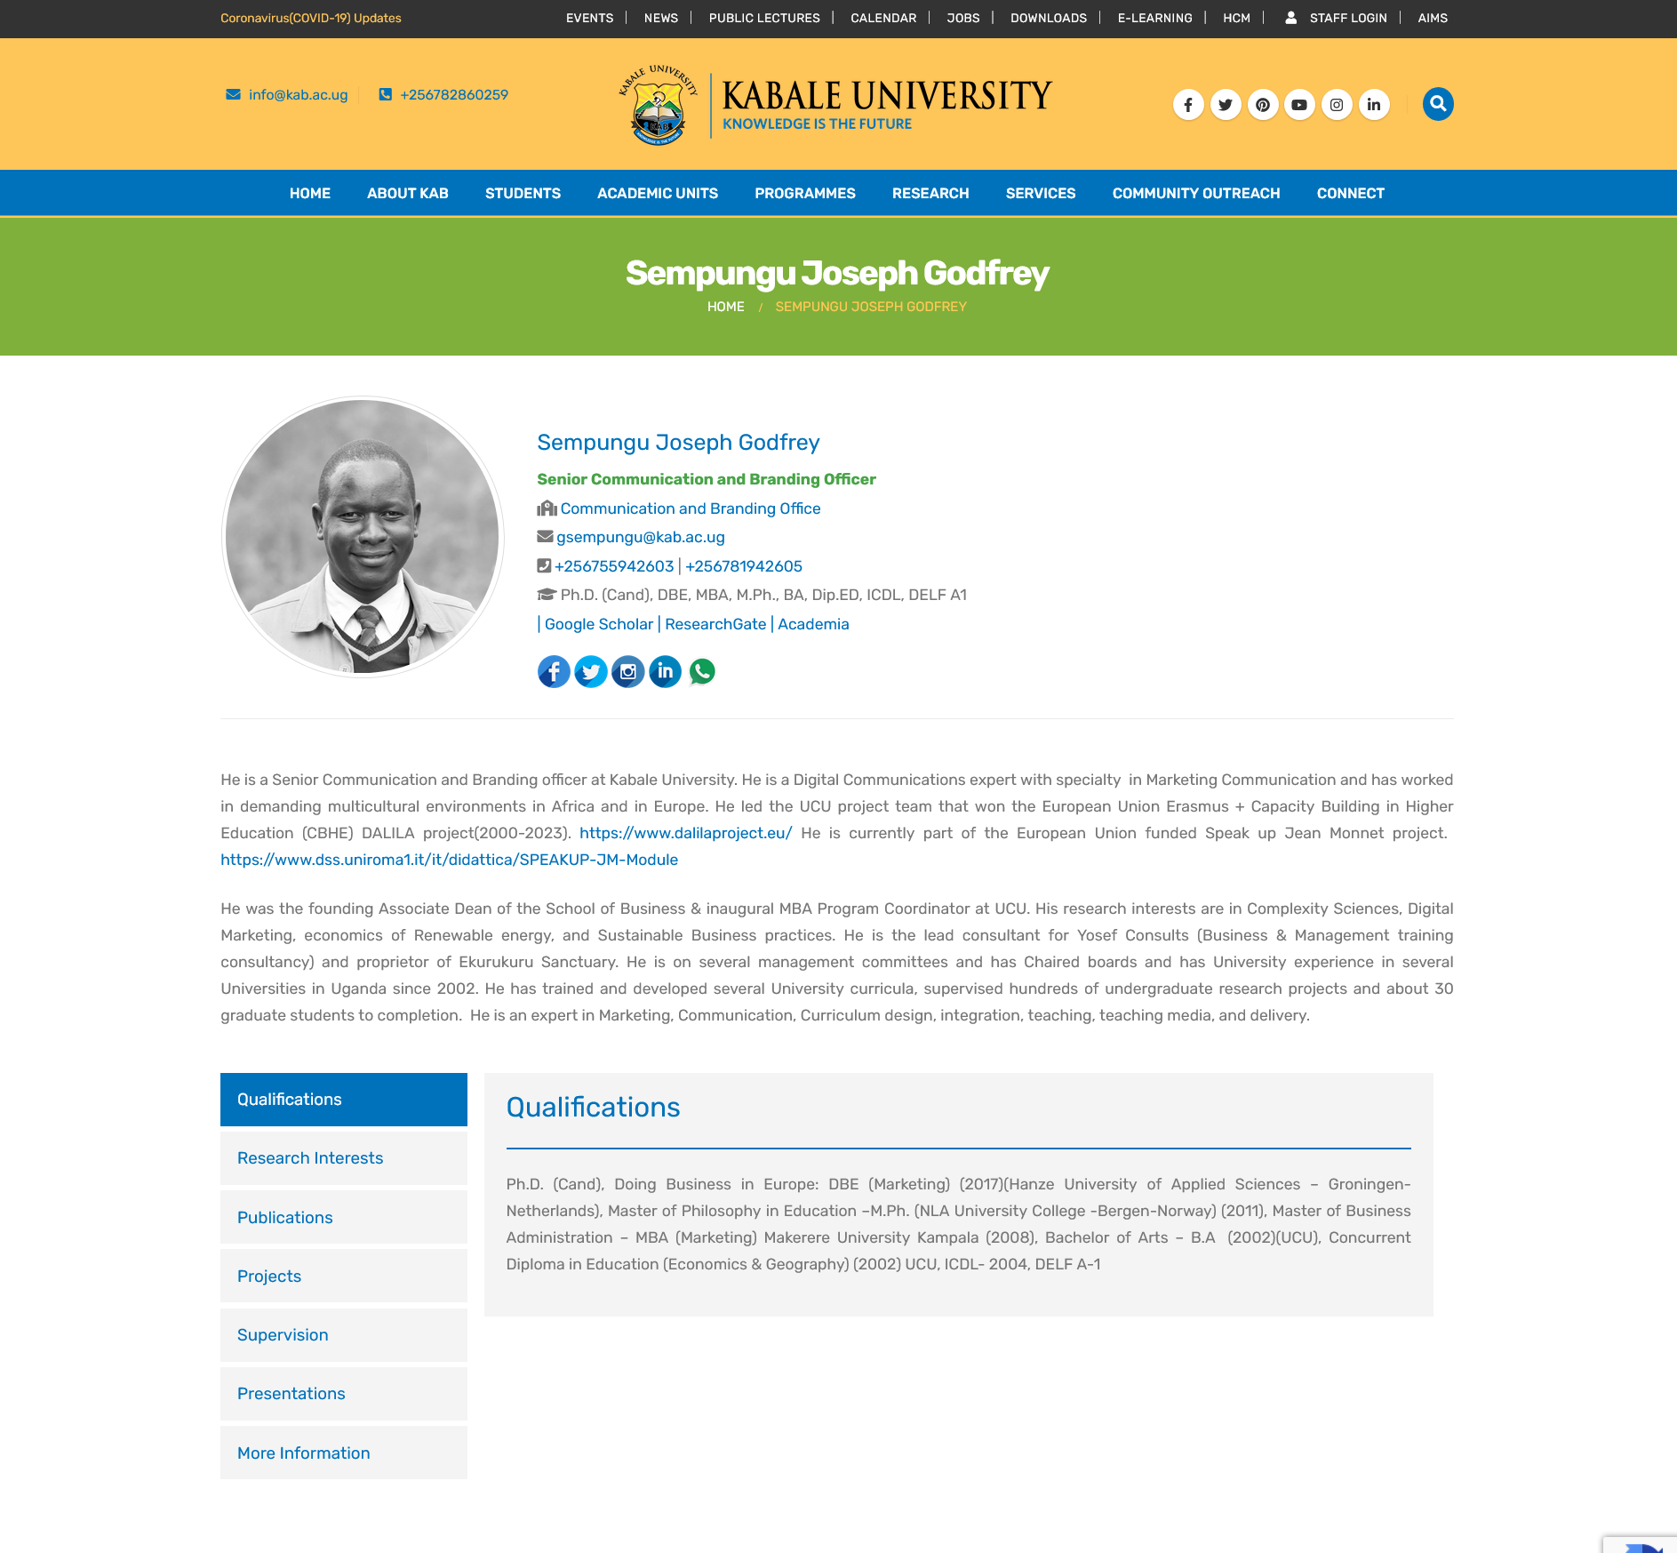
Individual Staff Profile

Slide 14
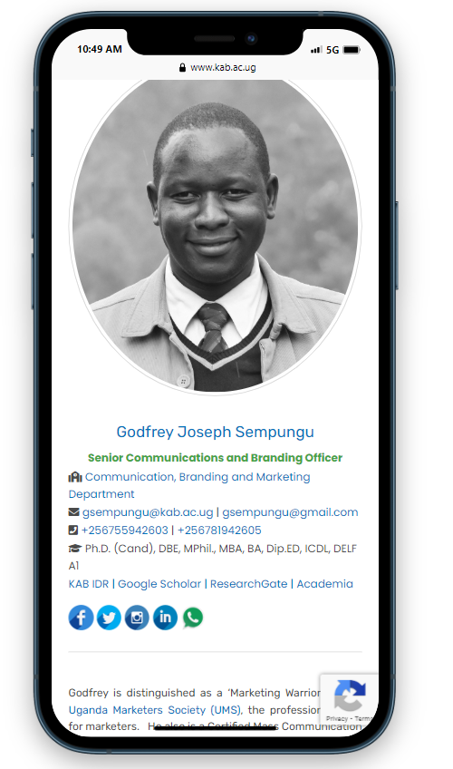
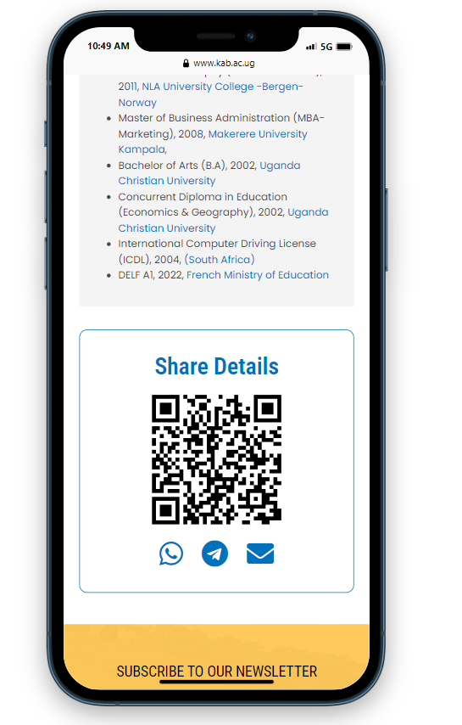
Digital Business Card
It’s Free/No Printing costs
Brings traffic to our website
Showcases Staff skills
It’s Green (Eco Friendly)
It’s Shareable
It can be updated

Slide 15
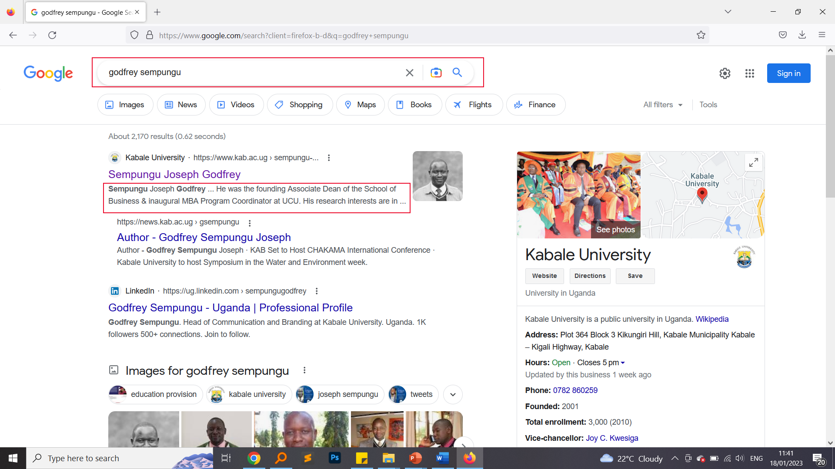
Google Search

Slide 16
Social Media …/kabuniversity
Facebook (facebook.com/kabuniversity)
Twitter (twitter.com/kabuniversity) or @kabuniversity
Linkedin (linkedin.com/school/kabuniversity/)
Pinterest (pinterest.com/kabuniversity/)
Youtube (youtube.com/channel/UCcZ4qivAFG1FmXWCkj3R31w)
Instagram (instagram.com/kabuniversity/)

Slide 17
University Email KAB Email
Staff Names: Collins Nowamani
Staff Email: cnowamani@kab.ac.ug
Password:

Slide 18
Example 2
Staff Names: Collins John Nowamani
Staff Email: cjnowamani@kab.ac.ug
Password:

Slide 19
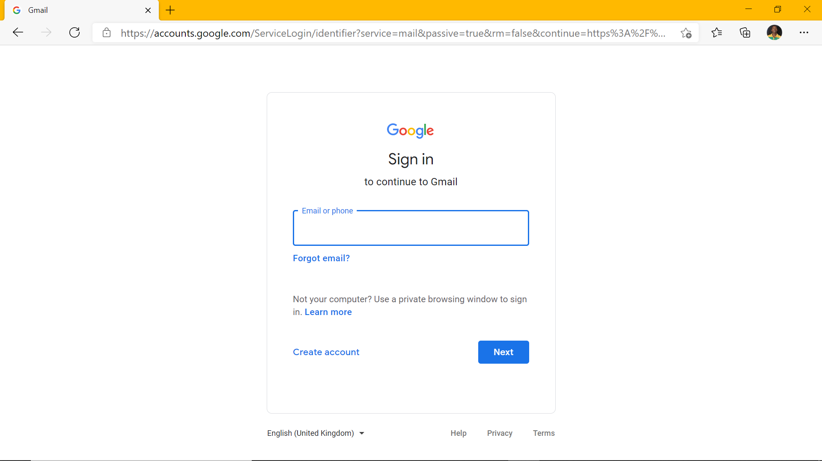
Email Login gmail.com

Slide 20
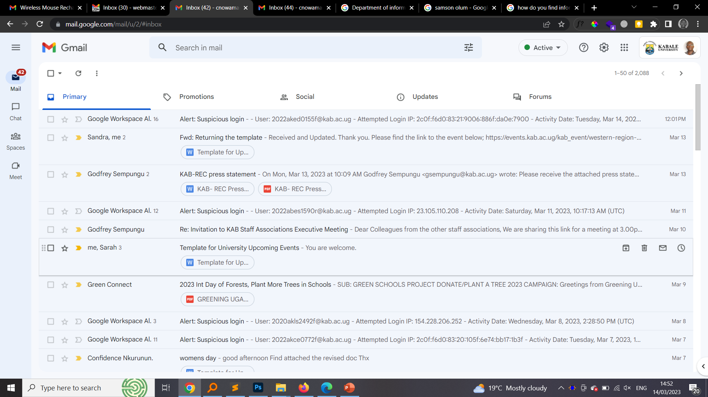
Gmail for Kabale University

Slide 21
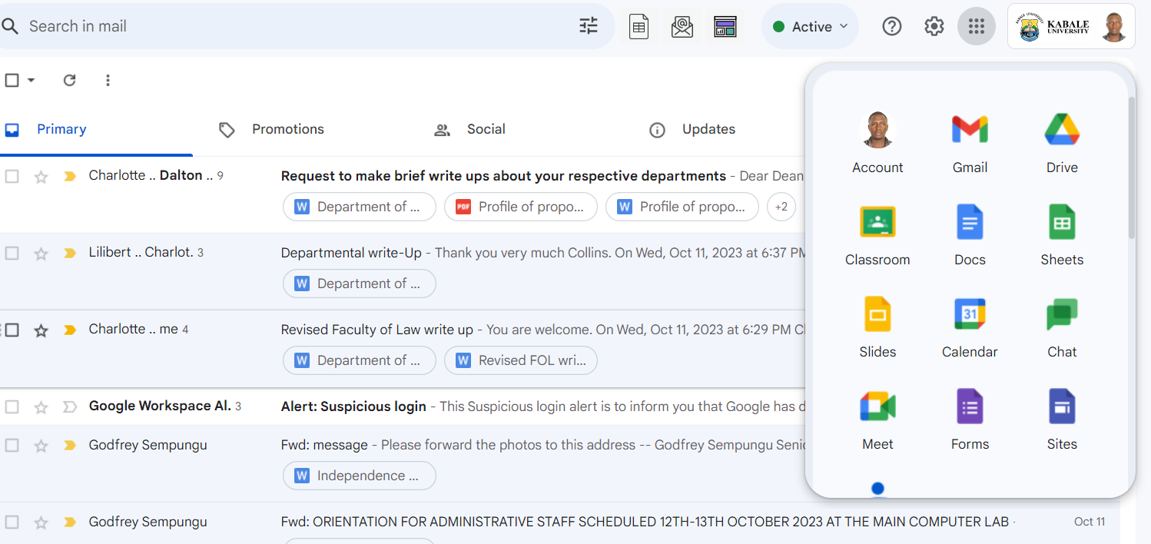
Email Additional Services
Drive, Classroom, Docs, Sheets, Slides, Calendar, Meet, Forms, Keep, Password Manager… etc

Slide 22

On Mobile /Phones

Slide 23
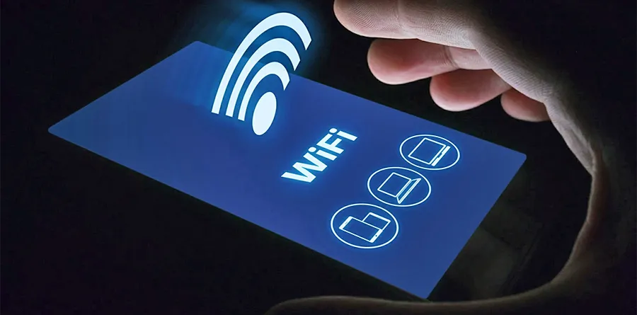
Connect to Eduroam Wi-Fi with University Email

