Slide 1
Orientation for newly appointed HoDs
Presentation to New HODs
On 18.04.2024

Slide 2
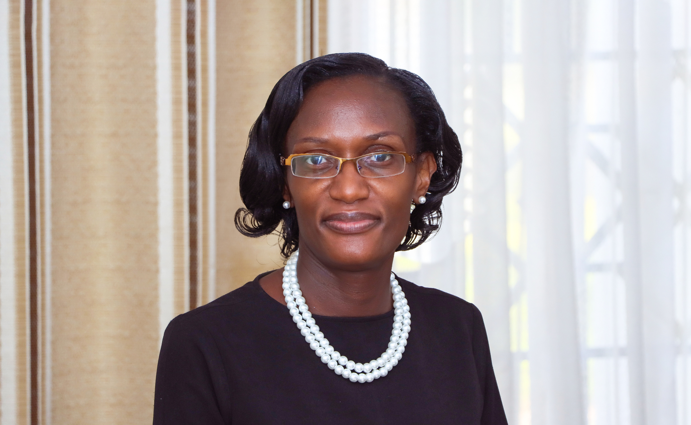
Facilitated by
Anny Katabaazi-Bwengye (Mrs.)
Deputy Vice Chancellor (F & A)
akbwengye@kab.ac.ug | dvcfa@kab.ac.ug

Slide 3
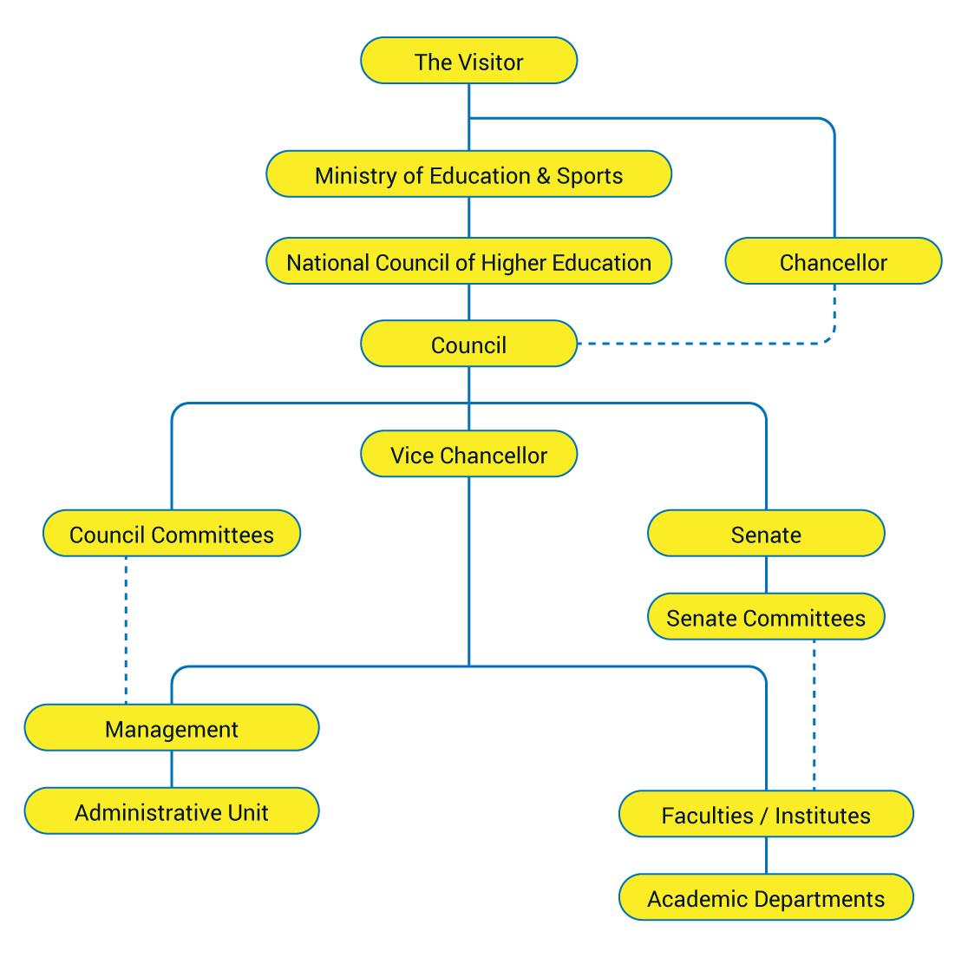
KAB Organogram

Slide 4
Structure of the presentation
KAB Organogram
Communication structure
Essential Documents
Staff Development Processes
Etiquette /Customer care
Chairing / Managing meetings
Handling Academic promotions

Slide 5
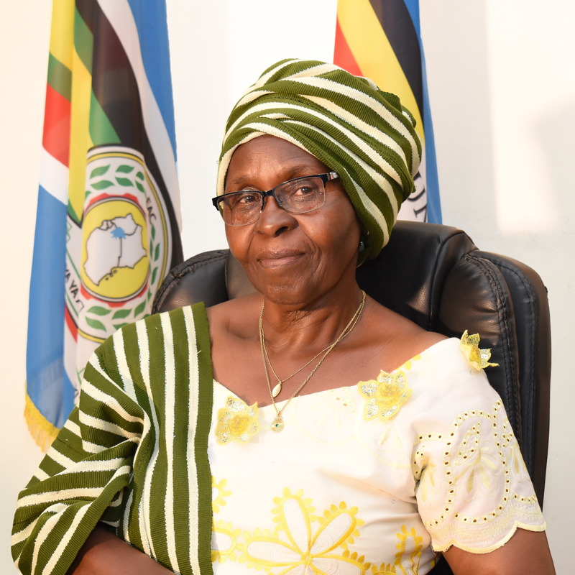
University Management
Professor Joy C. Kwesiga
Vice Chancellor
jckwesiga@kab.ac.ug I vc@kab.ac.ug
Anny Katabaazi – Bwengye (Mrs.)
Deputy VC - Finance and Administration
akbwengye@kab.ac.ug | dvcfa@kab.ac.ug

Slide 6
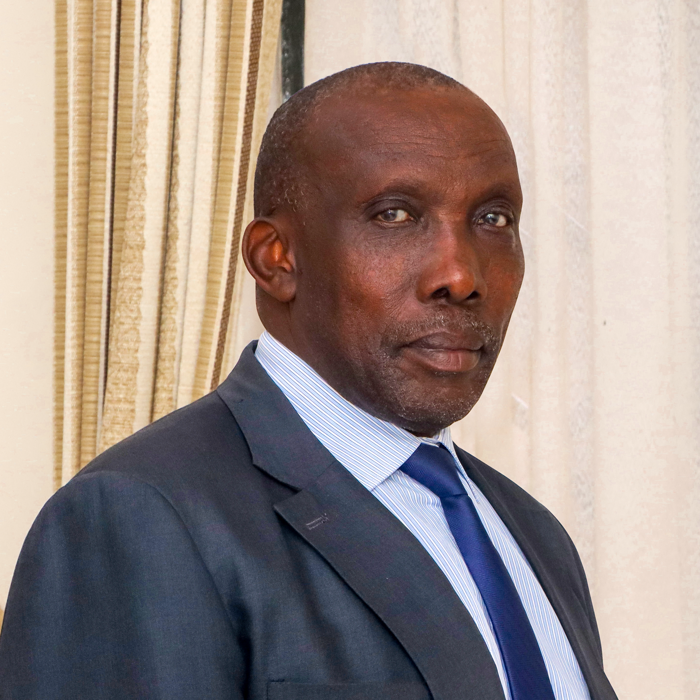
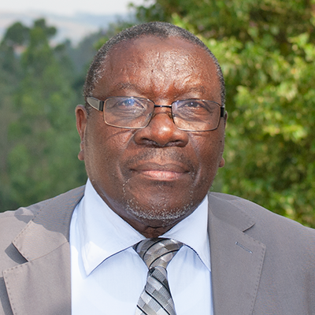
University Management
Baryantuma Johnson Munono
University Secretary
jbmunono@kab.ac.ug
Tibenderana Narcicir
Academic Registrar
ntibenderana@kab.ac.ug

Slide 7
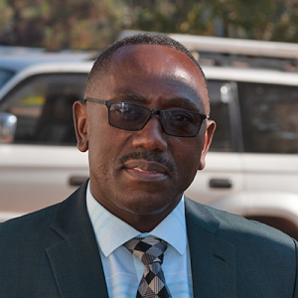
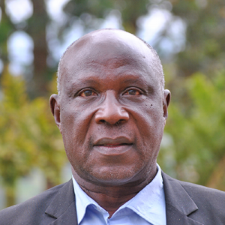
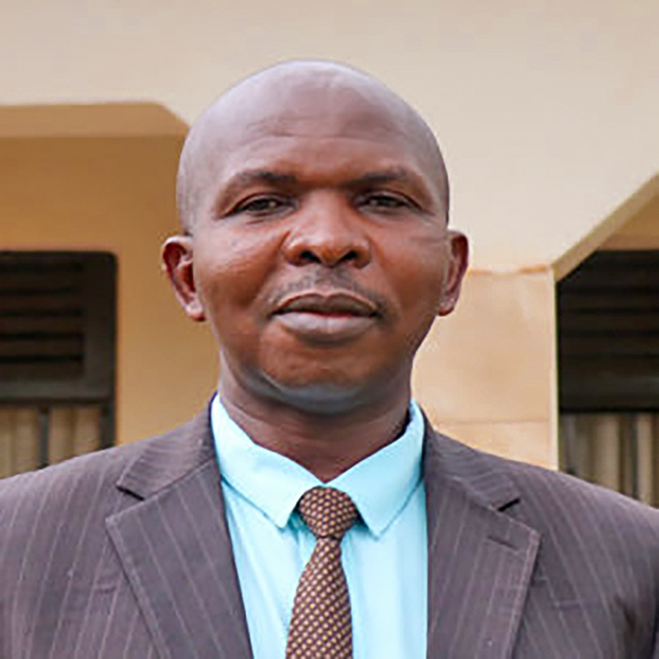
University Management
Mr. Tukamushaba Amos
Dean of Students
atukamushaba@kab.ac.ug
Dr. Bernard B. Bazirake
University Librarian
bbazirake@kab.ac.ug
Mr. Gad Twesigye
University Bursar
gtwesigye@kab.ac.ug

Slide 8

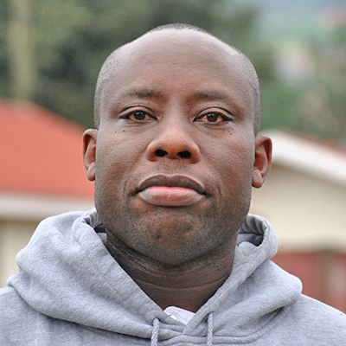
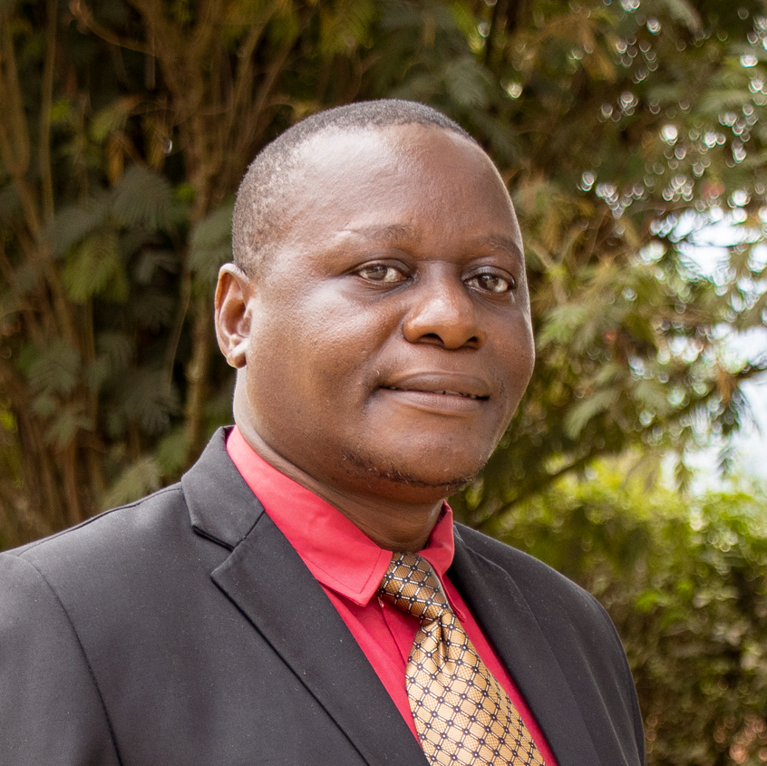
Deans, Chiefs, Deputy Chiefs
Dr. Julius Alexander
Chief, Directorate of Research and Grants jaarinaitwe@kab.ac.ug
Jones Murangira
Deputy Chief, ICT Services
jmurangira@kab.ac.ug
Assoc Prof. Sekiwu Denis
Chief, Directorate of Postgraduate Training
dsekiwu@kab.ac.ug

Slide 9
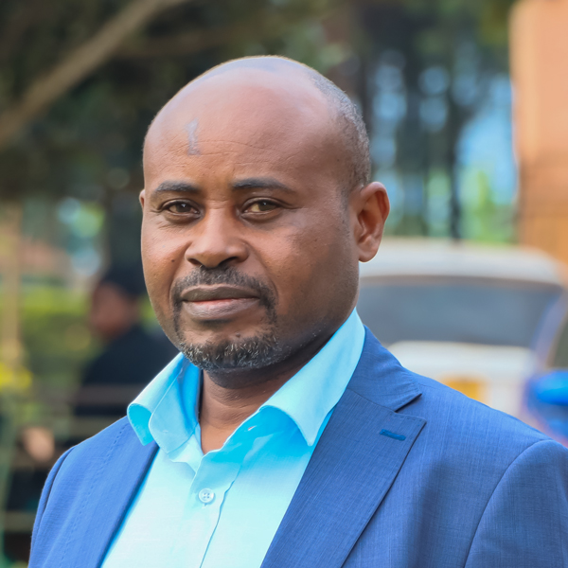
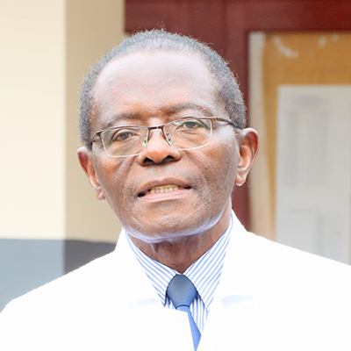
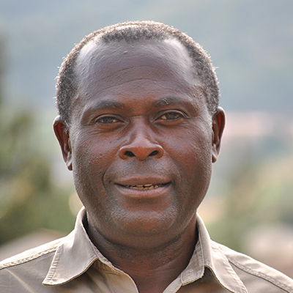
Deans, Chiefs, Deputy Chiefs
Prof. James K Tumwine
Dean, Kabale University School of Medicine (KABSOM) jktumwine@kab.ac.ug
Assoc Prof. Bamwerinde Mwetonde Wilson
Dean, Faculty of Agriculture and Environmental Sciences
wbamwerinde@kab.ac.ug
Assoc. Prof. Lawrence Muhwezi
Dean, Faculty of Engineering, Technology, Applied Design and Fine Art
lmuhwezi@kab.ac.ug

Slide 10
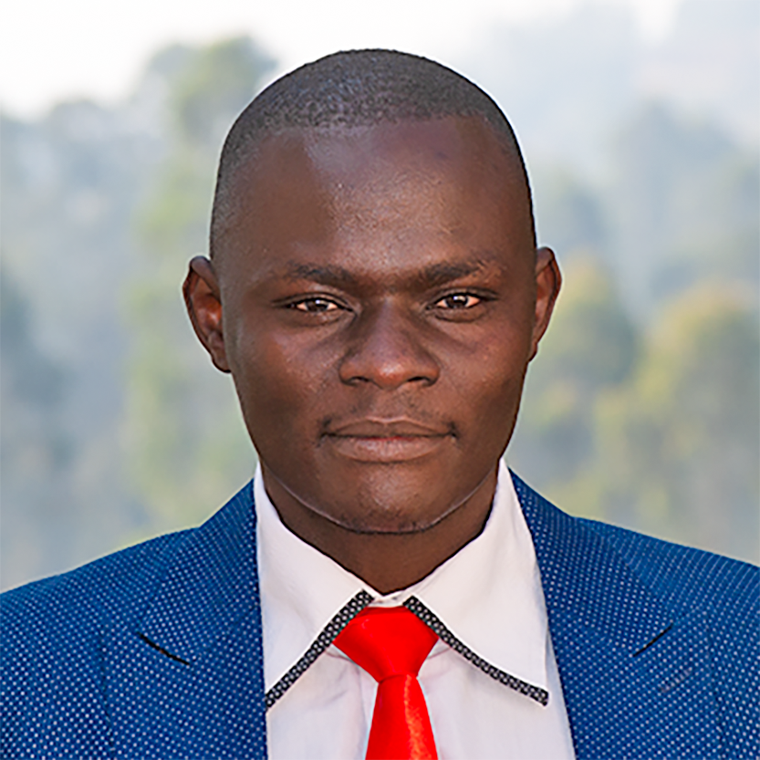
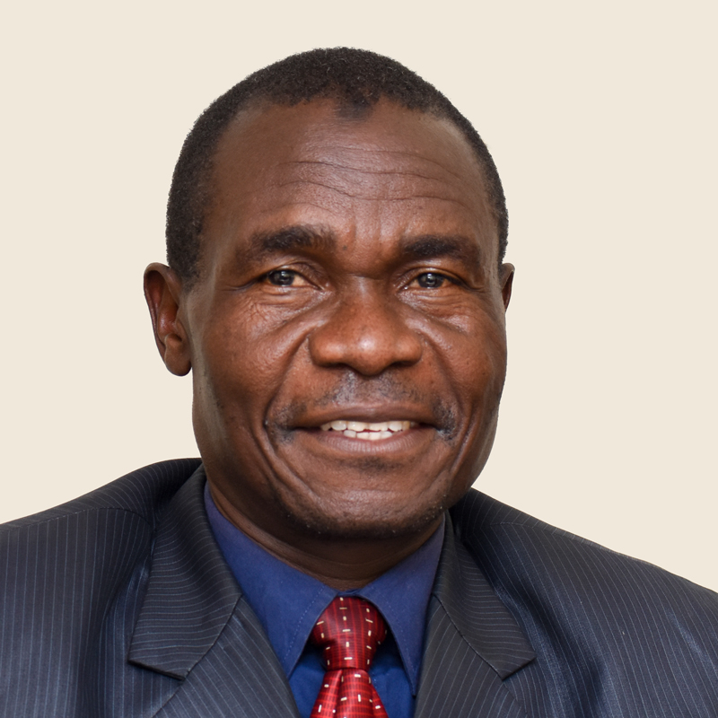
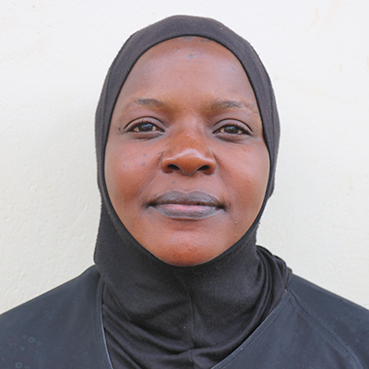
Deans, Chiefs, Deputy Chiefs
Assoc. Prof. Businge Phelix Mbabazi
Dean. Faculty of Computing, Library and Information Science
pmbusinge@kab.ac.ug
Assoc. Prof. Sarah Nachuha
Dean, Faculty of Sciences
snachuha@kab.ac.ug
Prof. Siraje Kaaya
Dean, Faculty of Economics and Management Sciences
skaaya@kab.ac.ug

Slide 11
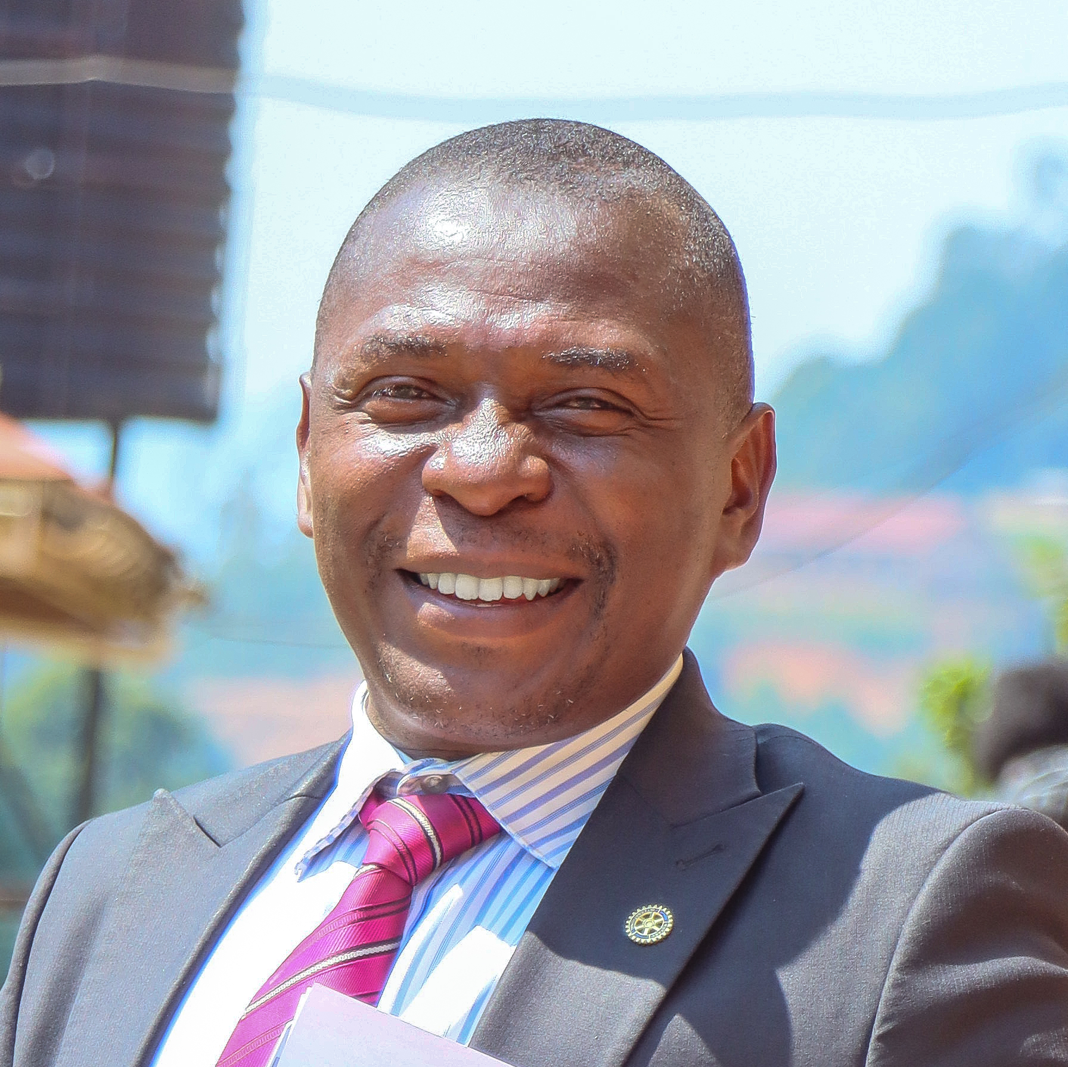
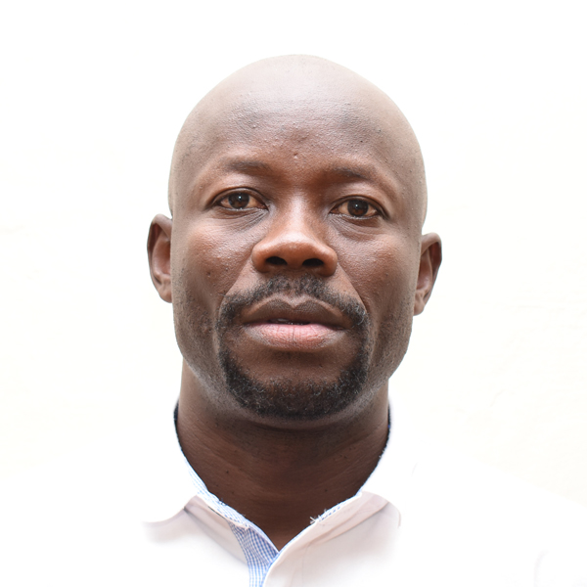
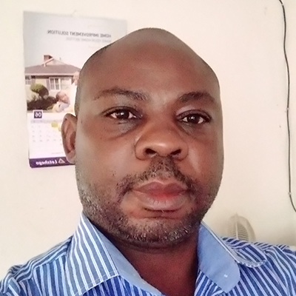
Deans, Chiefs, Deputy Chiefs
Assoc. Prof. Katusiimeh Mesharch Walto
Dean. Faculty of Arts & Social Sciences
mkatusiimeh@kab.ac.ug
Dr. Francis Akena Adyanga
Dean, Faculty of Education
fakena@kab.ac.ug
Dr. Majariwa David
Director, Institute of Language Studies
dmajariwa@kab.ac.ug

Slide 12
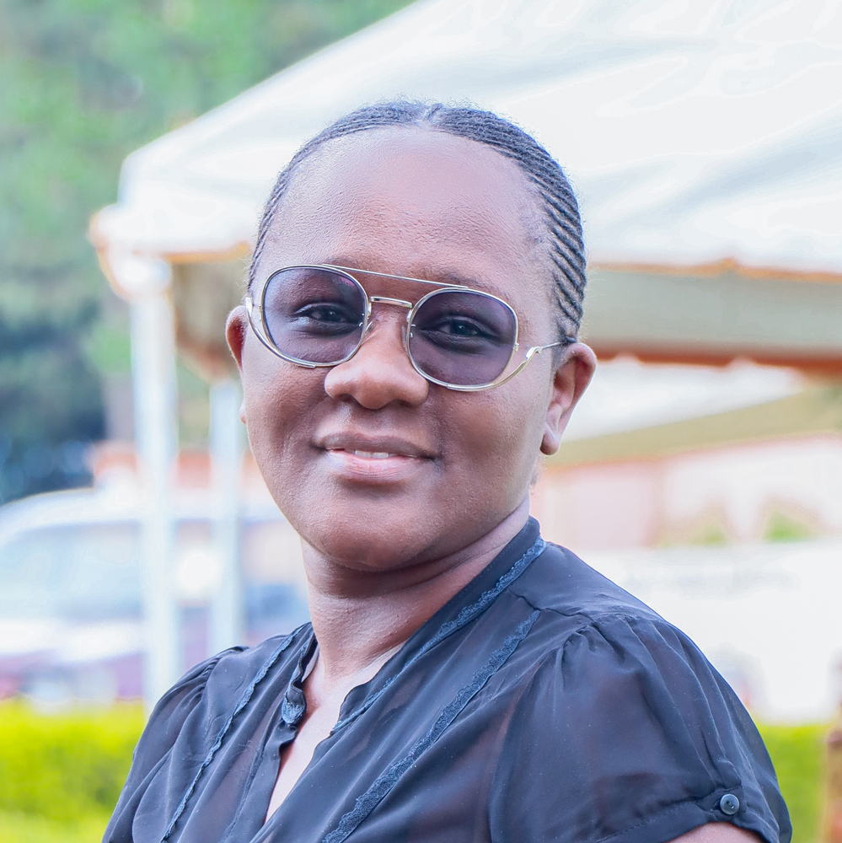
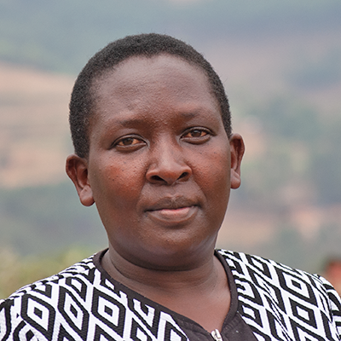
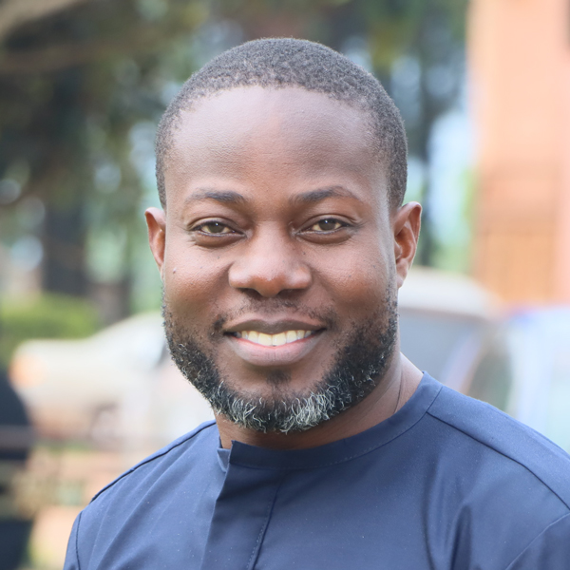
Deans, Chiefs, Deputy Chiefs
Dr. Charlotte Kabaseke
Dean. Faculty of Law
ckabaseke@kab.ac.ug
Dr. Christine Ampumuza
Chief, Institute of Tourism and Hospitality
champumuza@kab.ac.ug
Mr. Samson Olum
Chief, HRM
solum@kab.ac.ug

Slide 13
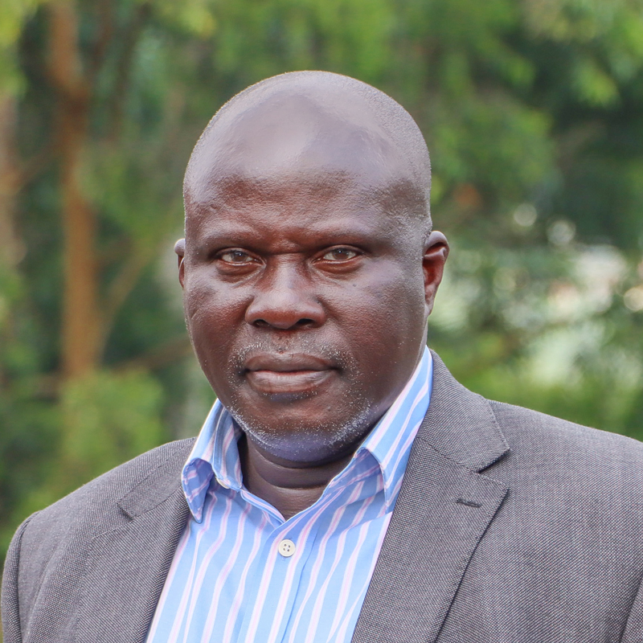
Deans, Chiefs, Deputy Chiefs
Mr. Benon Barigye
Deputy Chief, Internal Audit
bbarigye@kab.ac.ug

Slide 14
Heads of Departments / units
Academic Departments and service units –for the full list, please visit: www.kab.ac.ug

Slide 15
COMMUNICATION STRUCTURE
AT KABALE UNIVERSITY

Slide 16
Communications structure…..
The Chairperson of the University Council – can communicate on behalf of the University to the Chancellor and the Visitor and rarely to the Public
The Vice Chancellor is the Chief Communications Officer of the University and is charged with the protection of the University’s image
Secretary to Council – Communicate resolutions of the Council and its Board / Committees
Secretary to Senate – Communicates resolutions of the University Senate and other Senate Committees / working groups

Slide 17
Communications structure….2
Secretaries to Committees / in house – communicates with permission from the Chairperson
Senior Communications and Branding Officer – Ordinary Internal / External with the expressed permission of the Vice Chancellor
Press release was written by the VC but distributed by the SCBO
Advertisements / Radio talk shows etc
Issuance / deliveries / receipt of letters and other related documents
This is the mandate of the University’s Central Registry
Letter writing
For example; to the University Secretary through the Dean / Chief etc

Slide 18
Communications structure…..3
Letter writing (spell checks / composition / construction)
Dates
Salutation
Subject
Body (greeting, content / message)
Closure
Appreciation
Salutation
Signature
Carbon copies (cc) – take care (send those copies please, XX personal Lawyer)

Slide 19
Communications structure…..4
Official email writing – (spell checks / composition / construction)
Dates (e-date can work)
Salutation
Subject
Body (greeting, content / message)
Closure
Appreciation
Salutation
Signature
Carbon copies (cc) – email reply (restraint must be exercised)

Slide 20
Communications structure…..5
Internally – Follow hierarchy and not all things have to go to the VC – this approach delays responses!!!!
Annual Leave application in faculty, why should a staff or HoD apply for leave from the VC.
Why should a lecturer write or complain directly to the VC when a Faculty has a HoD and a Dean
Matters sent to management must be with the knowledge of the HoD or Dean
2. Externally - the University must know – double dipping (research, etc

Slide 21
Communications structure…..5
Use of University email addresses / letter heads / Stamps / Logo etc
Should strictly be used for University Business
Branded items for the prepare use (e.g. wearing of branded shirt in a bar etc)
Use of Official Job Titles as per your appointment / engagement letters at the University
Violation of the communication channels may be construed among others as; insubordination / abuse of office / attempt to disorganise the prepare management of the University

Slide 22
ESSENTIAL DOCUMENTS
AT KABALE UNIVERSITY

Slide 23
Essential Documents……
The Constitution of the Republic of Uganda, 1995 (as amended)
The Universities and Other Tertiary Institutions Act, 2001 (as amended) and Regulations made thereunder
Employment Act, 2006 (as amended)
The Uganda Public Service Standing Orders, 2021
The Leadership Code Act, 2002

Slide 24
Essential Documents…..2
The Public Service Act, 2006
KAB Human Resource Manual, 2022
The Statutory Instrument establishing KAB
KAB Strategic plan
Approved prevailing HR Structure as issued by the Public Service
Vision 2040
National Human Resource Development Plan 2020/21 – 2024/2025

Slide 25
Essential Documents…..3
All academic policies as approved by Senate / University Council
Sexual harassment policy
Gender and inclusiveness policy
Quality assurance policy
ICT and E-Learning policy
Academic and examination policy
Staff Development Policy (HR Manual)
Academic and non-teaching policy (HR Manual)
Rewards and sanctions policy (HR Manual)

Slide 26
Essential Documents…..4
Job Descriptions and Personal Specification for each approved job title
The Code of Conduct and Ethics for Uganda Public Service, 2005.
Other relevant Acts of Parliament and Government Policies passed
Health, safety, occupational policy
Other KAB Policies approved by the University Council

Slide 27
STAFF DEVELOPMENT PROCESSES
AT KABALE UNIVERSITY

Slide 28
Staff development procedures
A staff who wishes to study shall apply through his/her Department/Faculty Board to the University Secretary.
Departments/Units and Faculty and Directorate Boards shall meet to discuss the applications before submission to the University Secretary.

Slide 29
Staff development procedures…2
Departments/Units shall ensure that the workload of staff recommended for study are covered and the names of the persons identified to do the work shall be submitted along with the recommendation of the Committee.
Where an application has not been recommended, reason for must be stated.

Slide 30
Staff development procedures…3
On receipt of the recommendations of the Department and/or Faculty Committees, the University Secretary shall forward the applications and the recommendation to the Head of the Human Resource Department to present to the SDC for consideration.
Applications of staff for study programs shall reach the SDC at least two months before the commencement of the study program.

Slide 31
Staff development procedures…4
All applications forwarded by the Department/Unit heads shall be presented to the SDC for consideration regardless of whether or not they have been recommended.
Extract of the Department/Unit Minutes of the meeting, which recommended the applicant for study programs shall be attached to the application submitted to the Head of Human Resource Directorate for presentation to SDC

Slide 32
Staff development procedures…5
The Head of Human Resource shall present the recommendation to SDC for consideration.
The Head of Human Resource Directorate shall communicate the Decision of SDC to the applicant through his/ her Dean.

Slide 33
Staff development procedures…6
The University Secretary shall present the recommendation of SDC to the Top Management.
The University Secretary shall present the recommendation of Top Management to AB.
The University Secretary shall communicate the decision of the AB to the concerned staff.

Slide 34
Staff development procedures…7
Progress reports
Invoices
Other related documents

Slide 35
ETIQUETTE / CUSTOMER CARE
AT KABALE UNIVERSITY

Slide 36
GREETING
Welcome and greet people who come to your office / Lecture
Smile and make eye contract with the student / colleague etc
After you have greeted your client, listen to them with full attention.
Regardless of rank or appearance – all people coming to your office for the first time are either Sir or Madam
Good morning etc…my name is Anny xxx / Professor xxx, the Head of Department, English ……. How may I assist you.
After serving them, please thank them and bid them a good bye

Slide 37
Integrity
We shall commit ourselves to ethical and responsible behaviour in our own actions and to developing the same commitment in our Students, thus fostering individuals who will have the skills, knowledge, and ability to engage positively with a diverse and changing world.

Slide 38
Emotional Intelligence
1. Listen and understand the situation
Always listen to the client / colleague
Avoid interrupting and responding immediately
Encourage the client / colleague to share a little, so as you can fully understand the situation.
Do not jump into conclusions
2. Offer Empathy
Acknowledge the presence of a client / colleague
Show them that you care or are willing to serve them
Pay extra attention to the details

Slide 39
Customer care ..
That Student / Colleague you despise today may end up in a bigger office later in life……tables change.
Some of Us claim to be Christians / or saved but there is no compassion in the way we serve God’s people.
We must learn to treat our Students / Colleagues well and serve them politely.
Apply your mind and focus on the Customer (Student / Staff) before you.

Slide 40
Customer care….2
It is very important in an attempt to provide excellent customer service for Staff and Student etc to know the services provided.
Our core aim is to teach, research, innovate and provide solutions to the host community and ultimately contribute to the Human Resource capacity development - NDP III and vision 2040.
Customer care is about knowing your customer and making a sincere attempt to meet and / or exceed their expectations.
Before you enter your duty station, off load your baggage / trouble - outside and prepare yourself to receive the client or colleague.

Slide 41
Customer care ….3
Customer care is the role of everyone in the University. You may have an excellent VC but if the Security Officer, Office Assistant or Administrator is a terror the University will be branded poor or bad. People will give bad feedback
People will never forget how you make them feel when you are in charge.
How would you like people to remember you when you leave Office.

Slide 42
Balancing professionalism and personality
Avoid at all times to present yourself as a terror or difficult person but make efforts to deliver a professional service.
Often some people even fear to enter an office / lecture simply because the incumbent has lost the professional touch…i.e. proud tendencies and at worst rude.

Slide 43
CHAIRING / MANAGING MEETINGS
AT KABALE UNIVERSITY

Slide 44
Chairing / managing meetings
HoDs should have regular scheduled meeting to maintain team work, monitor progress and outputs of the department.
The HoD is responsible for the discipline of his or her department

Slide 45
Roles of a Chairperson….
Provide leadership to the Department in executing the Faculty duties and responsibilities.
Convene Department meetings
Ensure that there is lawful quorum for the meetings.
Chairing meetings of Department and ensuring that the Department focuses on its key tasks and mandate.

Slide 46
Roles of a Chairperson….2
Guide the meeting without dominating the proceedings, allocate enough time to each item and ensure that approved Agenda is adhered to.
Direct the meeting in a way which stimulates open discussion, of business t to reach appropriate resolutions.
Sum up discussions of Department proceedings so that members take ownership of what has been agreed upon for recording as resolutions.

Slide 47
Roles of a Chairperson….3
Ensure that Members receive accurate, timely and correct information
Consult Department Members on the appropriateness of the agenda
Ensure that all Department Members comply with the rules of procedure for meetings, other relevant laws and good practices

Slide 48
Roles of a Chairperson….4
Keep track of the contribution of individual members and ensure that they are all involved in discussions and decision making
Monitor the implementation of Department resolutions in a timely manner
Confirm minutes of the meetings

Slide 49
Roles of a Chairperson….5
Use tactic to ensure that meetings are not distracted by intricate arguments, or leap to hasty conclusions without due consideration.
Present and defend Department resolutions both internally and externally at any forum

Slide 50
Secretary / AA….
In consultation with the HoD, Issue meeting notices and prepare business for the meeting at least 3 / 5 days before the meeting.
Compile and dispatch the agenda for Department meetings as approved by the HoD.
Take accurate minutes and ensure they are signed off for prepare filing;

Slide 51
Secretary / AA…2
Keep good custody of Department records and always have a signed master copy relating to backup documents for reference and one copy kept with the registry.
Communicate decisions of Department in writing and update Members on the actions completed with evidence of completion.
Perform any other functions as may be assigned by the HoD.

Slide 52
Length of meetings
If well planned, meetings should not exceed three (3) hours
Draft Minutes should be made available within five (5) working days from the date of the meeting of the meeting.

Slide 53
Minutes of the University
All proceedings of University meetings shall be recorded in an intelligible manner, in line with the agenda with clear resolutions. The record shall encompass topics or issues discussed and decisions/resolutions reached and time – bound actions assigned.
At the next Departmental meeting, previous minutes shall be confirmed and signed in duplicate/triplicate as a correct record of the meeting by the Chairperson and Secretary who shall initial on every page.

Slide 54
Format of University Minutes
Minutes shall be written in a tabular format following the approved agenda, preferably in Microsoft Word
Font size12, in a trebuchet style, in black Colour font at 1.5-line spacing.
Minutes shall be numbered in an intelligible sequential manner and indented appropriately according to the agenda

Slide 55
Format of University Minutes….2
Minutes shall clearly indicate the issue being discussed and Resolution (s) recorded as announced by the Chairperson/HoD.
Minutes shall clearly indicate the officer (s) responsible for particular actions in the right hand column of the minutes (Tabular)

Slide 56
Format of University Minutes….3
Minute pages shall be numbered at the bottom with the appropriate footer indicating the full name of meeting, date and total pages in the document.
Meetings should be serialized e.g. 1st, 2nd FB meeting of 27th Nov 2020.

Slide 57
Action Report Format
Action extract report shall be drafted in a tabular format, preferably in Ms Excel
Font size 12, in a trebuchet style, in black Colour font at 1.5-line spacing.
With the following fields (Annex: -
Serial numbers
Minute Number and Page
Issue / Matter to be handled
Action Required
Responsible person / By Whom
Deadlines for actions
Status of actions

Slide 58
Action Report Format….2
Minute pages shall be numbered at the bottom with the appropriate footer indicating the full name of meeting, date and total pages in the document.
Meetings should be serialized e.g. 1st, 2nd FB meeting of 27th Nov 2020.

Slide 59
HANDLING ACADEMIC PROMOTIONS
AT KABALE UNIVERSITY

Slide 60
Academic Promotion
Criteria is in the HR Manual in line with NCHE
HR Structure / availability of funds
Department / Faculty
HR/US/Management /Appointments Board
Promotions above rank

Slide 61
Confidentiality
While confidentiality is an individual responsibility, each staff shall swear an oath of secrecy and allegiance and shall be bound by it.
All staff must personally take the necessary precautions to preserve the confidentially of information communicated or provided to him / her in confidence and not divulge it under any circumstances unless under compulsion of law or express authority of the University.

Slide 62
CLOSING
We thank you for choosing Kabale University as your place of work, it is my sincere prayer that you find Kabale University a place where you grow your career and other aspirations
Wish you the very best of your stay at Kabale University
“Knowledge is the future”

Slide 63
Thank You for Listening
Welcome | Tw’abakiira | Karibu | Bienvenue

