Slide 1
Counselling in the 21st Century
Kabale University Staff on Wednesday 28th February 2024.

Slide 2
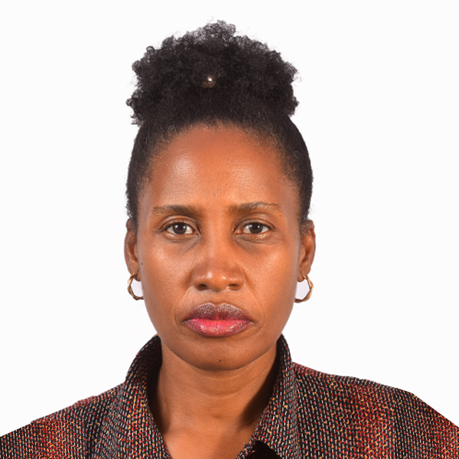
Presentation by
Asiimwe Confidence Nkurunungi
University Counsellor ,
Department: Dean of Students
Kabale University | cnasiimwe@kab.ac.ug

Slide 3
Presentation outline
What is Counselling?
What are the major goals of counselling?
Who needs counselling?
Parenting digital children
Family challenges
Mental health
Mental illness
Signs and symptoms of poor mental health
Mantaining positive mental wellness
Benefits of positive mental wellness

Slide 4

What is counselling?
Counselling is a professional relationship between a professional counsellor and a client with the aim of supporting him or her to cope with life’s challenges.

Slide 5
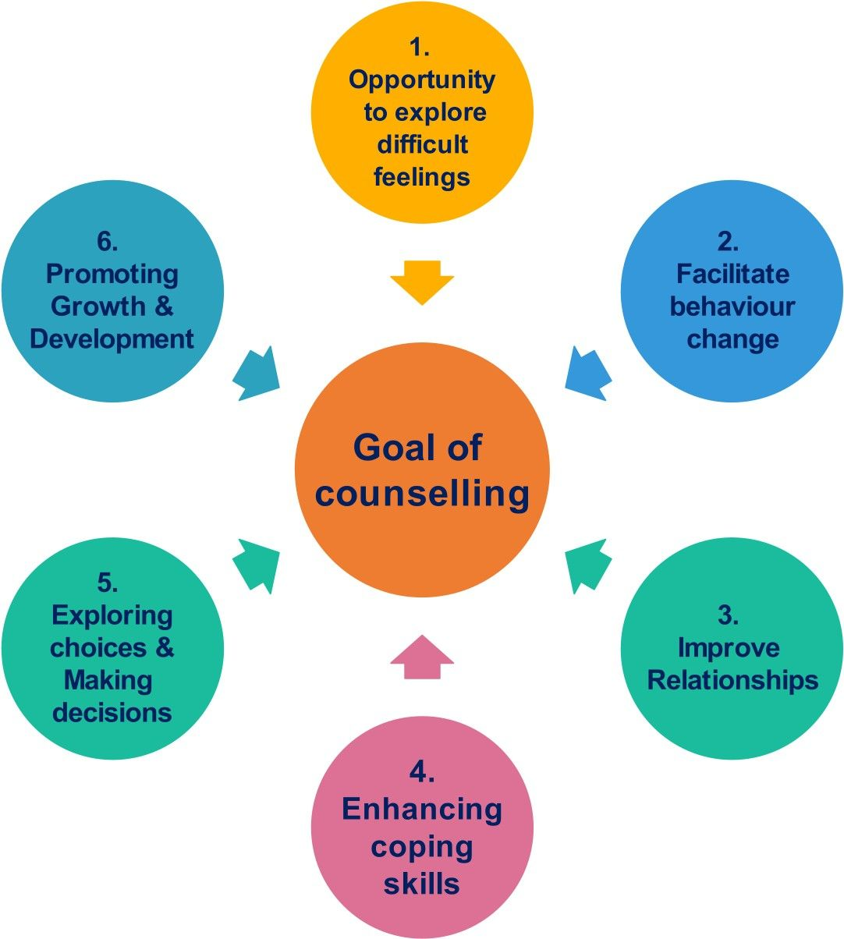
The Goals of counselling
To help people to navigate difficult life situations, these can be short term or long term.

Slide 6
Who needs counselling?
Any person dealing with a stress full situation, these can include but are not limited to;
Family challenges eg domestic violence,
Parenting challenges
Mental health challenges like, depression, anxiety, Ptsd,
Financial challenges , employment challenges
Grief
Addictions
Dealing with any other chronic illness

Slide 7


Challenges of Parenting digital children
Lack of TIME to,
Nature an emotional attachment
Monitor their activities especially on the social media.
To know their friends
The generation gap leading to
Poor communication
Mixed values

Slide 8


Parenting challenges conti…
Poor or no Structure
Weak or no Boundaries
Peer pressure
Children's Rights
Drug and substance abuse

Slide 9

Family challenges
Domestic violence Leading to;
Excessive stress,
Mental ill health ie depression and anxiety,
social isolation,
Shame, self stigma
Physical exhaustion,
Substance abuse

Slide 10
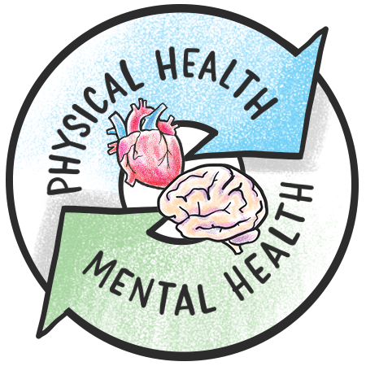
What is mental health/wellness
Mental health is the mental well being of a person which involves their thoughts feelings and actions. Or
The ability to understand self and others, solve problems ,cope with life's challenges, connect with others and understand the world around you

Slide 11
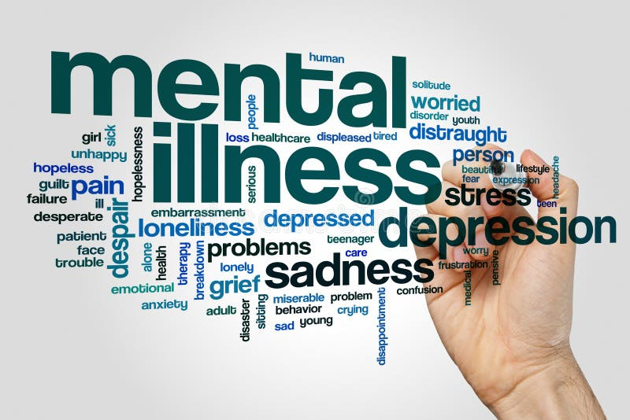
What is mental illness?
Mental illness /mental disorder is a behavioral or mental pattern that causes significant impairment in the normal functioning of an individual.
Mental disorders are usually defined by a combination of how a person
Thinks
Feels
Perceives and
Behaves

Slide 12
Causes of mental illnesses/disorders
These can range from;
Heredity (Biological)
Drug and substance abuse
Life pressures ,relationships
Chronic illness or Injury Loss of job
Increased financial obligations with no money
Family pressure ie domestic violence
Divorce
Death of a loved one

Slide 13
Who is at Risk?
Any body can develop a mental illness, although some people are more susceptible than others. Especially those predisposed (due to heredity) and early use of drugs and substances.
However, with the right treatment and support, any one struggling with a mental illness can live and function well in society.

Slide 14
Signs and symptoms of poor mental health
Pulling away from people and usual activities
Feeling numb or like nothing matters
Feeling helpless and hopeless
Smoking , drinking or using drugs more than usual
Feeling unusually confused , forgetful, on edge, angry, upset or worried
Experiencing severe mood swings that cause problems in relationships
Having persistent thoughts and memories you cant get out of your head

Slide 15
Symptoms conti….
Hearing voices or believing things that are not true
Thinking of harming yourself or others
Sleeping too much or too little
Mood disorders (such as depression or bipolar disorder
Anxiety disorder, substance use disorder
Personality disorder
Psychotic disorders (such as schizophrenia)
Trauma- related disorders (such as PTSD)

Slide 16


How to maintain mental wellness
1. Developing healthy responses like;
Exercising regularly
Eating a healthy diet
Avoiding alcohol and drugs
2. Take time to recharge by
Learning to relax, deep breathing, meditation
3. Establish boundaries
Work- life balance, proper use of technology

Slide 17

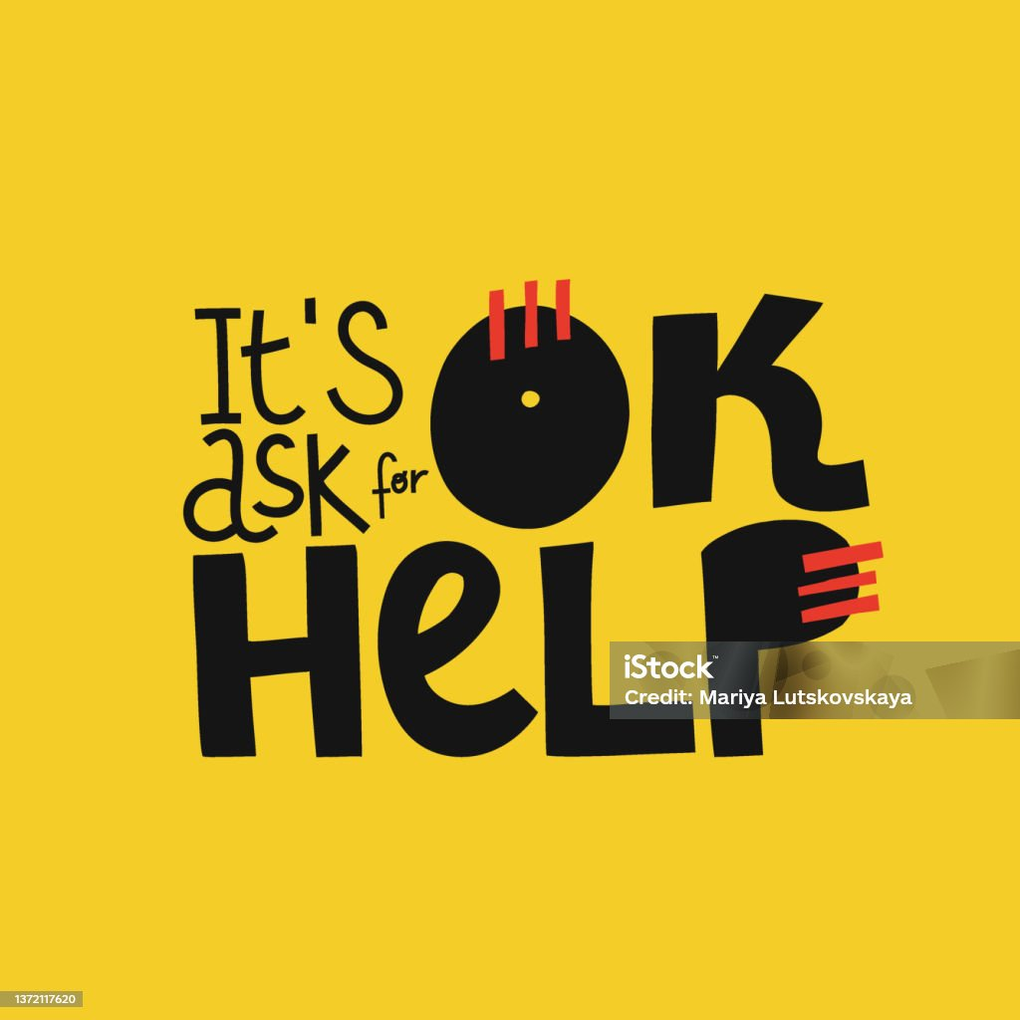
How to maintain cont…..
Track your stressors, write them down and try to avoid them.
Connecting with others
Staying positive
Getting enough sleep
Getting professional help (therapy)
Eat health foods, fruits and vegtables
Drink plenty of fluids.

Slide 18
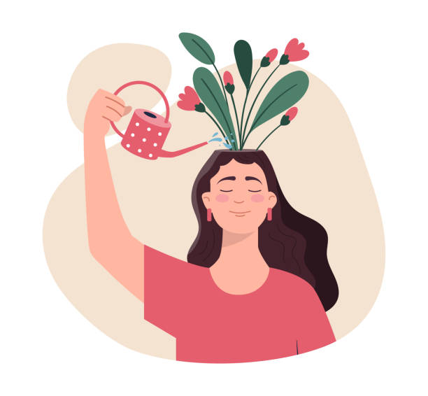
Benefits of positive Mental Health
Increased self love
Cope with the stressors of life better
Make meaningful contributions to self, family and society
Work productively
Realize their full potential
Enjoy others company thus building strong reltionships
Improved emotional inteligence

Slide 19
Important quotes
Mental illness is not a choice But treatment is’’
‘’The strongest people are not those who show strength in front of the world but those who fight and win battles that others do not know about’’
Jonathan Harnisch

Slide 20


Thank you
Any Questions?

