Slide 1
The Role of Research and Innovation in the growth of Higher Education Institutions
A presentation made to a Public dialogue at KAB on 8/10/2022

Slide 2

Key note Speaker
Prof. Benon C. Basheka, PhD, FCIPS
Professor of Governance
First Deputy Vice Chancellor – Academic Affairs
Kabale University
bbasheka@kab.ac.ug

Slide 3
Introduction
Background
Traditional Roles of a University
The university institution has survived, together with the church, as one of the oldest western institutions.
The engrained tradition of teaching–research–service trinity in the university is the activities of disseminating, creating and applying knowledge
University Trinity Roles
Teaching
Research
Service

Slide 4
In the modern University, Innovations have been added
The Modern
University
Teaching
Research
Service
Innovation
Knowledge Dissemination

Slide 5
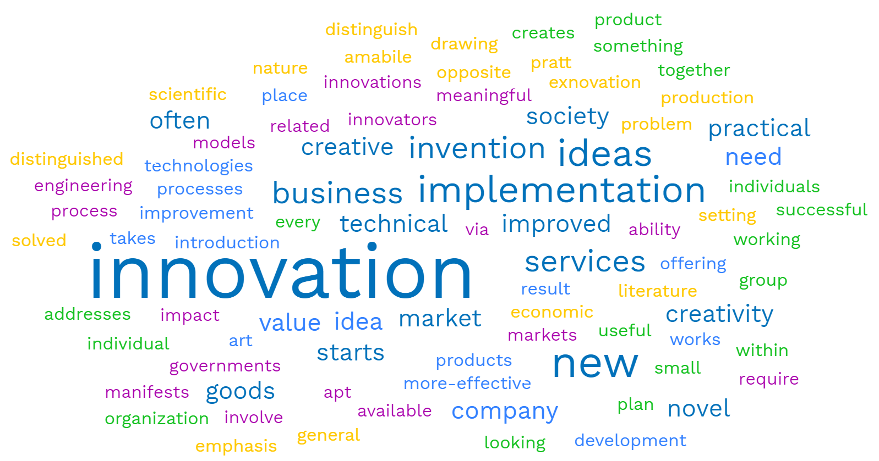
Innovations, Inventions and patents as IPs

Slide 6
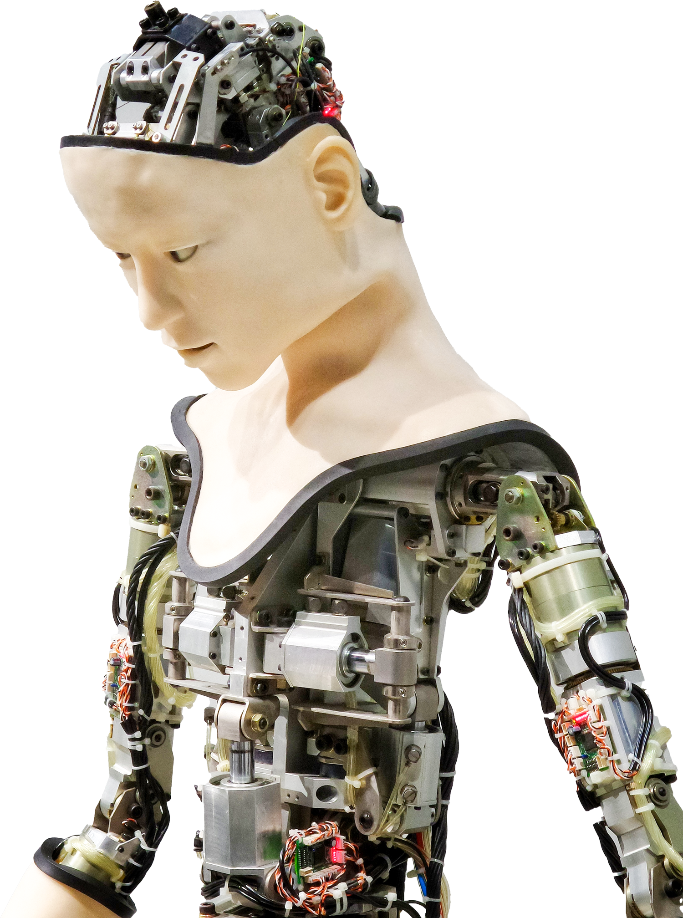
Innovations, Inventions and patents as IPs
Innovations are part of the intellectual property rights (IPRs).
Rights given to persons over the creations of their minds-Copyrights, patents, trade marks.
They give the creator an exclusive right over the use of his/her creation for a certain period of time.
An innovation when equated to an invention is a solution to a specific technological problem-a product or a process and generally has to fulfil three main requirements:
it has to be new
not obvious and
there needs to be an industrial applicability.

Slide 7

Why Innovation is Key to the University
It has now become almost impossible to mention the words ‘higher education’ without ‘innovation’ following closely behind.
Innovation is about staying relevant and sustainable in a globally unpredictable environment.
It is about strategically moulding the teaching and learning methodologies in H.E to:
Cultivate new ideas
Enhance creativity
Encourage collaboration, and
Promote inclusion and diversity.

Slide 8
Universities ought to drive innovation through many ways
Innovation in Universities
Fostering entrepreneurship
Universities embrace entrepreneurship as part of the academic experience, creating cultures where innovative thinking is inspired and nurtured.
Encouraging collaboration with the private sector
Universities develop new partnerships with leading companies, foundations, and other research-intensive institutions.
Promoting diversity and inclusion
Universities focusing on incorporating diverse perspectives into their work.
Exploring the nexus of technology and society
provide the ethicists, artists, and philosophers who can point the way; the policy experts and economists who can draw the map; and the cognitive scientists and sociologists who help ensure the destination is designed for people as well as machines.

Slide 9
Research: Why are universities engaged in the conduct of research?
To realise university missions around learning and discovery.
The pursuit of scholarship-fundamental or applied research, research-based scholarship or what often is called “scholarly activity” or creative activity.
The discovery of new knowledge
Provide greater understanding of complex challenges.
Exposing faculty and (administrators) who are engaged at the leading-edge of their fields, through their research and scholarly work.

Slide 10

Who pays for Research in Universities?
University research can be expensive, particularly in laboratory-intensive fields.
Faculty who are engaged in research write grants for funding to support their work and the work of their students and staff.
The universities do need to invest heavily in equipment, facilities, and personnel to support select research activities.
Research in the STEM fields (broadly defined) can also be expensive governments provide the funding.
Research councils and bodies- Medical research, and medical education more broadly, is expensive and often requires substantial institutional investment beyond what can be covered by clinical operations or externally funded research
Scientific and engineering research often involves specialized facilities or pieces of equipment, advanced computing capabilities, materials requiring controlled handling and storage, and so forth.

Slide 11
Emerging trends of research in Universities
Multidisciplinary Research
physical, natural, and social scientist teams pursuing large grant funding-due to the nature of the complex problems being studied
Philanthropy
May also be directed toward the support of research and scholarly activity at universities.
External Support
Support from individual donors, family foundations, private or corporate foundations may be directed to support students, faculty, labs or other facilities, research programs, galleries, centers, and institutes

Slide 12
Trends of funding of Public Universities in Uganda

Slide 13
Who benefits from research in Universities?
Students: Students benefit from studying in an environment rich with research and discovery.
University: The broader university benefits from active research programs.
Research on timely and important topics attracts attention, which in turn leads to greater institutional visibility and reputation.
As a university becomes known for its research in certain fields, they become magnets for students, faculty, grants, media coverage, and even philanthropy.
Strength in research helps to define a university’s “brand” in the national and international marketplace, impacting everything from student recruitment, to faculty retention, to attracting new investments.

Slide 14
Who benefits from research in Universities?
Community: The community, region, and state benefits from the research activity of the university.
Research contributes directly to economic development, clinical, commercial, and business opportunities.
Resources brought into the university through grants and contracts support faculty, staff, and student salaries, often adding additional jobs, contributing directly to the tax base.
Research universities, through their expertise, reputation, and facilities, can attract new businesses into their communities or states.
They can also launch and incubate start-up companies, or license and sell their technologies to other companies.
Research universities often host meeting and conferences which creates revenue for local hotels, restaurants, event centres, and more.
University medical centres provide high-quality medical care

Slide 15

Research and Growth of Chinese Universities - An Example
The quality and quantity of a country’s doctoral graduates is an important indicator of its future competitiveness.
The Chinese government views human capital as an important component of “comprehensive national power”.
Over the last two decades it has sought to expand the country’s educational capacity through substantial state investment.
China has consistently produced more STEM doctorates than the United States since the mid-2000s.

Slide 16

Research and Growth of Chinese Universities - An Example
By 2025 Chinese universities will produce more than 77,000 STEM PhD graduates per year compared to approximately 40,000 in the United States.
There are around 3,000 universities and colleges in China, which range widely in quality
At the pinnacle of Chinese higher education sit 42 universities that are designated as “Double First Class” (DFC) institutions—these receive a large share of central government education and research resources
In 2020, 36 of the 42 “Double First Class” universities were ranked in the top 500 universities globally, and 21 were ranked in the top 200

Slide 17
Role of state in research investment in china
The Chinese Ministry of Education roughly doubled its spending on higher education between 2012 and 2021
Between 2016 and 2019, the number of students entering STEM doctoral programs at Chinese universities increased nearly by 40 % ( from 59,670- 83,134).
The vast majority of PhDs graduating from Chinese universities are Chinese nationals.
China-based authors are producing an increasingly large share of top STEM publications.

Slide 18
Their journey has been long and strategic
1949–1976: the destructive legacy of the former Soviet model and of the Cultural Revolution
Universities were restructured into a political apparatus and an economic instrument for socialist political and economic development.
Academic freedom and institutional autonomy over knowledge production were removed from universities.
The value of knowledge was scrutinised and judged according to political ideology and its instrumental uses
After the establishment of the New China by the Chinese Communist Party in 1949, universities followed the Soviet model of reorganising academic disciplines and separating teaching from research.
Comprehensive universities were dismantled and divided into specialist colleges, covering science and technology, medicine, law, and so on.
Universities were restructured solely for teaching, and research institutes for research

Slide 19
Their journey has been long and strategic
1977–1997: second reorganisation of the university and its paradoxical development in economic transition
Chinese universities regained room for development with an increased degree of autonomy granted by the state
In the mid 1990s, there was a reverse reorganisation of Chinese universities, where the former divided and specialised colleges were encouraged to merge into large-scale comprehensive universities.
Ways of turning knowledge into money were restricted to teaching non-degree self-financing programmes and establishing university-affiliated enterprises.
Universities were pushed to the market to generate revenue, but the conversion of knowledge into wealth was not established nor institutionalised

Slide 20





Their journey has been long and strategic
During the late 1980s and early 1990s, university-affiliated enterprises grew and prospered in the name of generating revenue to support universities.
Some were just trading and running businesses with no reference to knowledge and technology, whereas some took advantage of research and knowledge application from researchers in the university

Slide 21
Their journey has been long and strategic
1998–to date: the expansion of higher education and the recognition of the value of knowledge in the knowledge economy.
The Internet became popular in China in the late 1990s.
Information technology changed the world and created new riches in China where IT companies received venture capital investment
The majority of the IT business leaders and the entrepreneurs of the hi-tech start-ups were graduates from the key Chinese universities
They made fortunes out of knowledge, innovative ideas and technology.
The connection between universities and the new economy was highlighted and became included in the discourse of the knowledge economy.
Knowledge production and transfer were no longer peripheral services as one of three uses of the universities

Slide 22
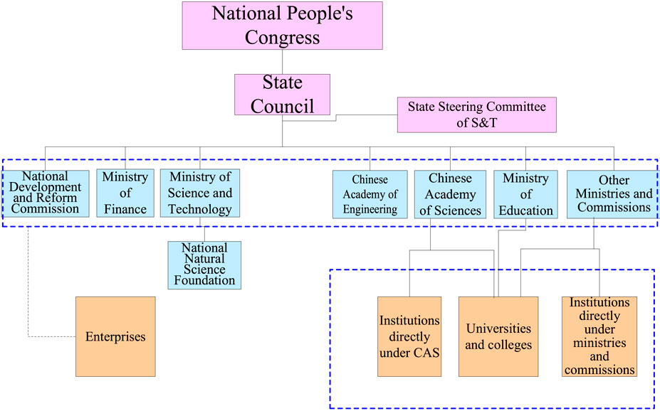
Science and technology funds management system of central government in China

Slide 23
LESSONS
Research and innovations are key to university growth and national development.
State policy on education and research matters
Deliberate strategy on PhD Production and support
Critical areas of human resource capacity development
Publication of scholars is a top agenda item
Classification of universities and focus identification is critical
Funding based on mandate of universities is critical
Domestication of Chinese strategy by individual universities like Kabale is possible.

Slide 24

RWENDEIRE Report findings
Very low completion rates at graduate level partly because of heavy supervision loads.
Students were unable to complete their PhD programmes in the mandatory three years
Staff productivity with respect to graduate students had declined from 1.2 in 2008/2009 to 0.9 by 2013/2014 (SSRs).
Whereas the number of PhDs had increased, graduate output had declined.
Graduate students expressed dissatisfaction with dilapidated teaching facilities and lack of reading space

Slide 25
RWENDEIRE Report findings – Cont’d
Most of the supervisors in the different disciplinary fields had consultancies and hence created little time for their supervisees. This affected Students’ progress.
The international students expressed lack of awareness of the existence of an International Office in the University, hence misdirecting their requests for student support in case of any challenges.
There was absence of mechanisms to track drop out, completion and graduation rates at Departmental, School and College level.
There was little or no documented evidence of online and offline academic consultations although individual lecturers offered such consultations, especially in the course of supervising graduate students.

Slide 26
Lessons from the Chinese story
One of the common measures is to level up the national research capacity through directly increasing public investment in R&D activities
It requires horizontal coordination with other policy support, such as setting up policies to attract the talents around the world, or to attract the R&D intensive Foreign Direct Investment (FDI)
The public and the private sector can build joint efforts to co-fund research institutes

Slide 27
Thank you!

